Slide 1
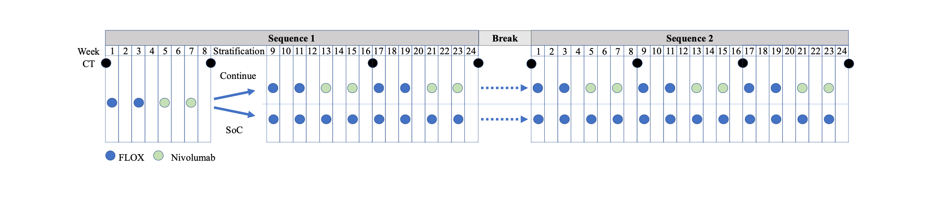


Radiologic biomarker-guided selection for first-line oxaliplatin-based chemotherapy and nivolumab
in metastatic MSS/pMMR colorectal cancer (CRC): preliminary METIMMOX-2 results
Sebastian Meltzer¹*, Anne Negård^{2,7}, Eva Hofsli⁴, Jørgen Smeby⁵, Herish Garresori⁶, Jūratė Šaltytė Benth^{7,3}, Anne Hansen Ree^{1,7}
Dep ¹Oncology and ²Diagnostic Imaging, ³Health Services Research Unit, Akershus Univ Hosp; ⁴Dep Oncology, St Olav’s Hosp; ⁵Dep Oncology, Oslo Univ Hosp; ⁶Dep Oncology, Stavanger Univ Hosp; ⁷Inst Clinical Medicine, Univ Oslo; Norway
793P
Background
Results
The randomized METIMMOX trial (NCT03388190) demonstrated that early radiologic tumor shrinkage correlated with response to alternating oxaliplatin-based chemotherapy and nivolumab in unresectable abdominal metastases from MSS/pMMR CRC.
The follow-up METIMMOX-2 trial (NCT05504252) prospectively applied this biomarker to guide treatment allocation.
A total of 57 patients were enrolled between 5-Oct-2022 and 17-Sep-2024, of whom 55 with a median of 10 days (range 1-28) from baseline radiologic staging to treatment initiation were evaluable.
30 patients with <10% TLR at first BICR restaging transitioned to SoC: 12 (40%) females, median age 61 years, median TMB 7, 18 (60%) KRAS/NRAS-mutant, and 7 (23%) BRAF V600E, with 15 (50%) stable disease and 15 (50%) progressive disease (left Figure; best overall response at first BICR restaging).
25 patients with ≥10% TLR continued experimental treatment (left Figure): 10 (40%) females, median age 62 years, median TMB 7, 12 (48%) KRAS/NRAS-mutant, and 1 (4%) BRAF V600E, of whom best overall response during their entire METIMMOX treatment included 4 (16%) complete response, 12 (48%) partial response, 7 (28%) stable disease, and 2 (8%) progressive disease (read-out 15-Sep-2026).
Median progression-free survival (PFS) was 14.6 months (95% CI 6.8–not reached), significantly better (p = 0.037; log-rank test) than in the METIMMOX chemotherapy-only arm (median PFS 9.2 months, 95% CI 6.3-12.7) (right Figure).
Methods
This multicenter, single-arm trial administered 2 cycles of FLOX chemotherapy (Q2W) followed by 2 cycles of nivolumab (Q2W) before the first radiologic restaging by blinded independent central review (BICR).
Patients with ≥10% target lesion reduction (TLR) at first BICR restaging continued alternating chemotherapy/nivolumab blocks; those with <10% TLR switched to standard-of-care (SoC). BICR was performed every 2 months.
A treatment break was introduced after 12 cycles, then up to 12 new cycles were resumed at progression, repeated until progressive disease on active therapy, intolerable toxicity, consent withdrawal, or death. All patients underwent TSO500 tumor sequencing.
Conclusions
An early, pragmatic biomarker (≥10% TLR) may enrich patients with abdominal metastases from MSS/pMMR CRC for clinical benefit from the METIMMOX regimen.
However, too early baseline CT timing could underestimate TLR and risk misclassifying patients who might benefit.
Acknowledgements: We are grateful for financial support from the Norwegian Cancer Society and its Umbrella Foundation for Cancer Research, as well as the South-Eastern Norway Regional Health Authority. Bristol-Myers Squibb has provided nivolumab free of charge.
*sebastian.meltzer@medisin.uio.no
Disclosure: The presenting author reports to have participated in an advisory board for GSK and presented for Bristol-Myers Squibb.

