Slide 1
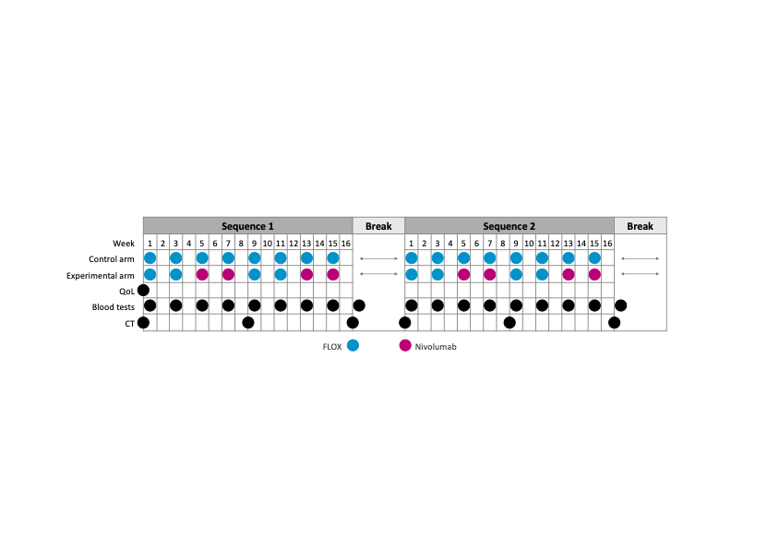
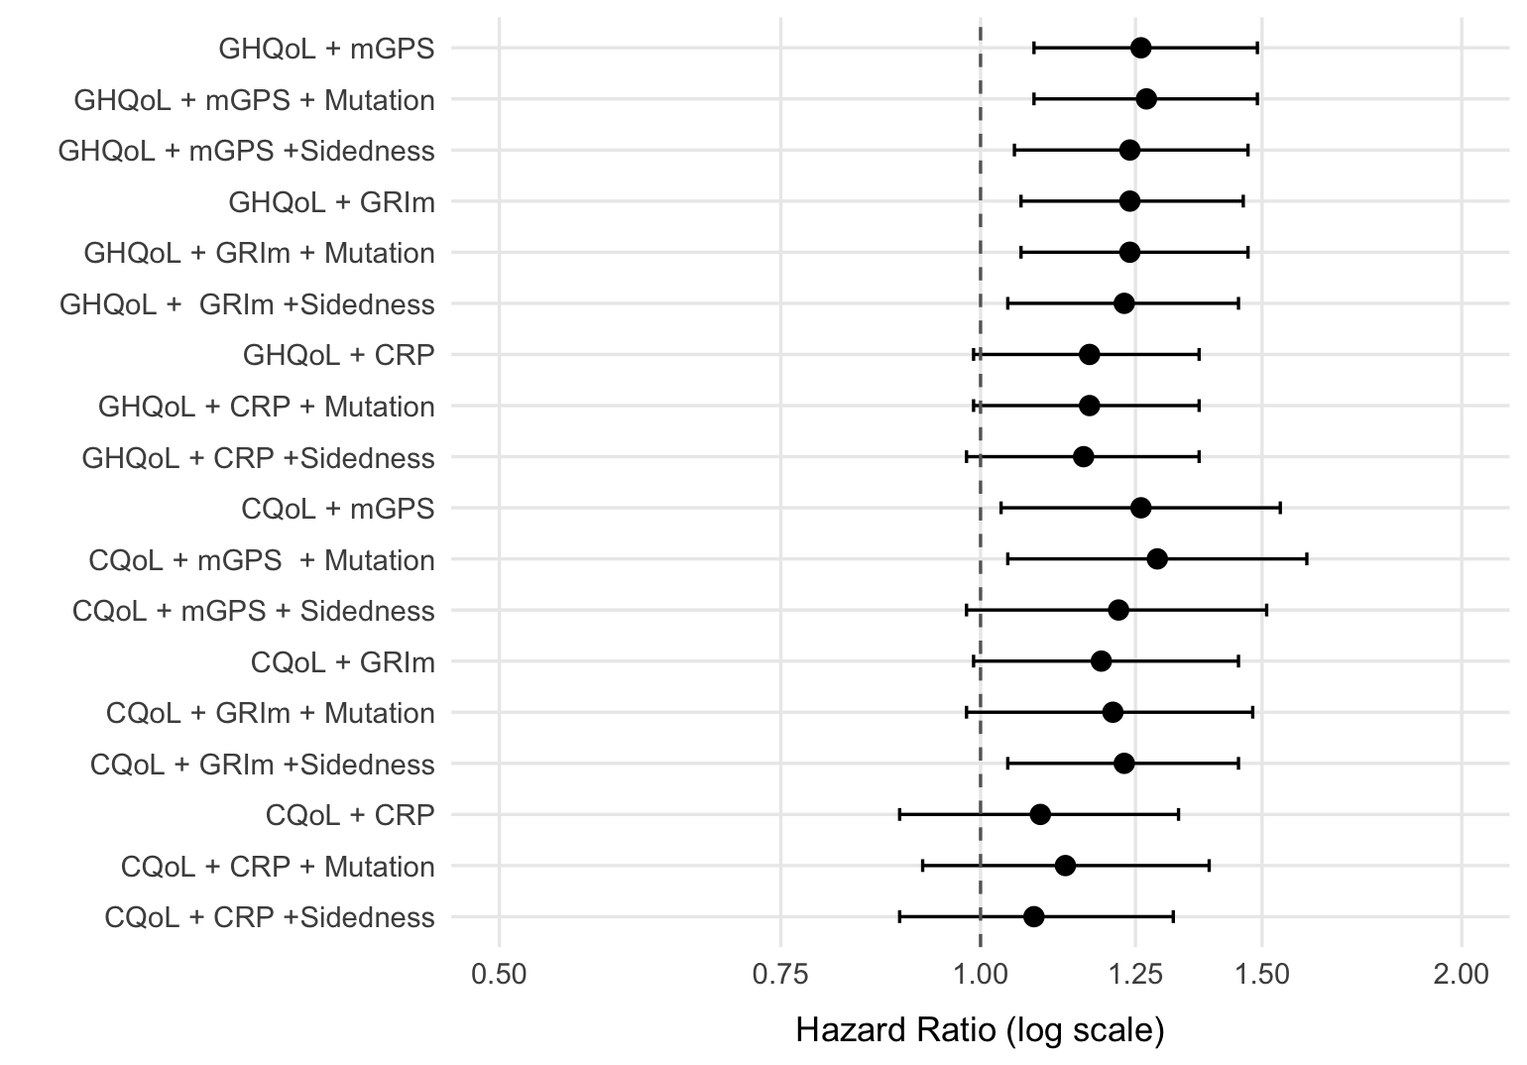


Self-perceived global health status as a prognostic factor for progression‑free survival (PFS):
a preplanned secondary analysis of the METIMMOX trial in metastatic microsatellite-stable (MSS) colorectal cancer (CRC)
Aleksandra Pirnat¹*, Paula A. Bousquet¹, Marianne G. Guren^{2,3}, Sebastian Meltzer¹, Anne Hansen Ree^{1,3}
¹Department of Oncology, Akershus University Hospital; ²Department of Oncology, Oslo University Hospital; ³Institute of Clinical Medicine, University of Oslo; Norway
3478P
Background
Results
The randomized phase 2 METIMMOX trial investigated first-line alternating oxaliplatin-based chemotherapy (FLOX) and nivolumab versus FLOX alone in unresectable abdominal metastases from MSS CRC, and showed identical median PFS – the primary endpoint – in the two arms.
All eligible patients had an ECOG performance status 0-1 at study entry.
We conducted a preplanned analysis to identify patient-reported outcome domains associated with PFS.
The mean baseline GHQoL score was 68.7 (SD 20.5), while the mean CQoL score was 17.9 (SD 12.9), both similar between arms.
Left figure below: Poorer GHQoL (higher scores) and higher CQoL (greater symptom burden, worse functioning) at baseline were consistently associated with increased progression risk, with GHQoL models appearing more robust across alternative adjustment sets, although somewhat attenuated when adjusted for CRP. In general, CQoL models showed weaker associations with progression risk, non-significant across most models.
After adjustment for inflammatory markers measured following the initial two FLOX cycles (identical treatment in both trial arms), poorer baseline GHQoL remained independently prognostic of shorter PFS (HR 1.25 per 10-point worsening, 95% CI 1.05-1.50, p = 0.012) across alternative adjustments, alongside CRP above the reference limit (HR 5.65, 95% CI 2.35-13.6, p < 0.001). Higher baseline CQoL was also associated with increased progression risk, but this was weaker and non-significant except in the CRP-adjusted model.
Methods
In 67 patients with complete follow-up, baseline quality of life (QoL) was assessed using the EORTC QLQ-C30 questionnaire.
We derived the Global Health QoL score (GHQoL) from Q29-30 and an exploratory composite symptom/functional index (CQoL) from Q1-28, both transformed to 0-100 scales. The GHQoL scale was reversed so that higher scores denoted worse self-perceived GHQoL, aligning its directionality with the CQoL index.
Given the multidimensional impact of systemic inflammation in patients with advanced CRC, several inflammatory markers were evaluated: C-reactive protein (CRP), the modified Glasgow Prognostic Score (mGSP), and the Gustave Roussy Immune (GRIm) score.
The trial arms were pooled because PFS was identical and because the trial was designed to exploit anti-tumor immunity induced by short-course oxaliplatin-based chemotherapy.
We examined associations between self-perceived global health status (GHQoL) or symptoms/functioning (CQoL), systemic inflammation, and PFS.
Cox models estimated HRs with 95% CIs per 10-point change on the 0-100 scale, adjusted for age, sex, trial arm, each baseline inflammatory marker, and tumor sidedness and mutation status.
Figure above: Adjusted PFS curves from a Cox proportional hazards model for CRP below versus above the reference limit (5.0 mg/L) after the initial two FLOX cycles. The model was adjusted for age, sex, trial arm, and GHQoL, and included a CRP-time interaction term.
Conclusion
Baseline self-perceived global health status was an independent prognostic factor for PFS in first-line treatment of metastatic MSS CRC, even after adjusting for systemic inflammation.
This suggests that how patients perceive their health may matter as much as symptoms, functioning, and biological CRC markers when refining prognostic assessment.
Disclosure: The presenting author has no conflicts of interest to declare.
*aleksandra.pirnat@ahus.no [pirnatdraleksandra@gmail.com]

