Slide 1
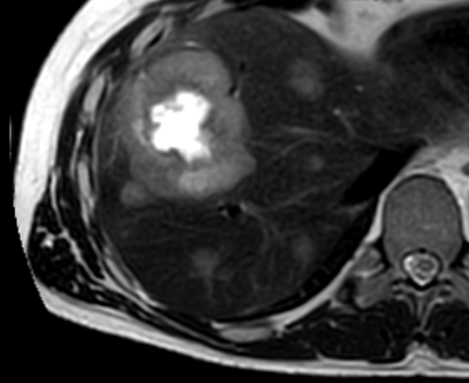
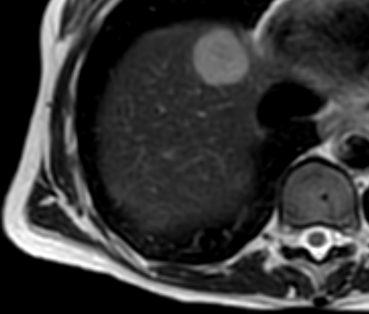
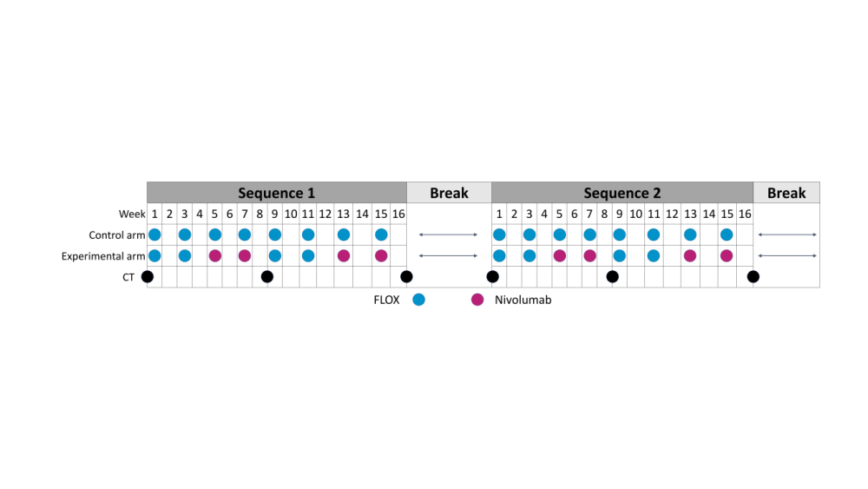


Clinical, radiological, and molecular indicators of outcome in metastatic microsatellite-stable (MSS) colorectal cancer (CRC)
treated with first-line oxaliplatin-based chemotherapy and nivolumab
Anne Hansen Ree^{1,3@}, Kine M. Bakke¹, Paula A. Bousquet¹, Stein Harald Holmedal², Anne Negård^{2,3}, Sebastian Meltzer¹
Departments of ¹Oncology and ²Diagnostic Imaging, Akershus University Hospital; ³Institute of Clinical Medicine, University of Oslo; Norway
795P
Background
Results
The randomized phase 2 METIMMOX trial (NCT03388190) investigated alternating oxaliplatin-based chemotherapy and nivolumab (2 cycles each) versus chemotherapy alone in unresectable abdominal metastases from MSS CRC.
An experimental-arm subgroup achieved unexpectedly long progression-free survival (PFS), clearly exceeding that of the control arm (median PFS 9.3 months).
We conducted a post hoc analysis to identify tumor factors associated with favorable outcomes.
Of 36 evaluable experimental-arm patients, 31 had EoT tumor data.
At baseline, BOC (n = 7) predominantly had right-sided primaries with metastases restricted to liver or lymph nodes, MOC (n = 8) had left-sided or rectal primaries with peritoneal or lung subsidiary lesions, while POC (n = 16) had extensive multiorgan involvement and hyperintense core liver metastases on MRI, suggestive of necrosis.
Patient |  | CRP (mg/L) |  | Primary tumor |  |  | Main metastatic lesions at baseline |  | Subsidiary metastatic lesions at baseline | Organ(s) with progressing metastases at EoT | Outcome
Age (years) | Sex | At baseline | Before first nivolumab | Site | Mutation status* | TMB | Involved organ | SLD (mm) | Involved organ(s) |  | BOR | TTP (months)
Best-outcome cases (BOC)
60 | F | 0.7 | 0.6 | Right | KRAS G12C | 10 | LN** | 32 | LN, Soft tissue | Soft tissue, Bone | CR | 41.6
58 | M | 1.6 | 1.0 | Right | MLH1 K618A | 12 | Soft tissue** | 40 | None | None | SD | Not reached at 40.0
68 | F | 16 | 3.0 | Right | KRAS G12V | 11 | Liver | 30 | Liver, LN | None | CR | Not reached at 36.4
73 | F | 8.3 | 3.1 | Right | BRAF V600E | 7 | Liver | 35 | Liver | Liver | CR | 35.0
72 | F | 1.0 | 1.1 | Right | BRAF V600E | 12 | LN** | 26 | LN, Peritoneum | None | CR | Not reached at 33.1
70 | F | 24 | 1.0 | Right | BRAF V600E | 7 | Liver | 42 | Liver, LN | Soft tissue, Bone | CR | 20.7
57 | F | 1.0 | 1.0 | Rectum | wt | 13 | Liver | 19*** | Lung | Brain | PR | 19.8
Moderate-outcome cases (MOC)
60 | M | 7.0 | 11 | Left | KRAS G12A | 1 | Liver | 50 | Liver, Lung | Liver | PR | 16.4
61 | M | 1.0 | 1.0 | Rectum | KRAS G12V | 7 | Liver | 35 | Liver, LN | Liver | SD | 15.8
72 | M | 21 | 1.0 | Rectum | KRAS A146, MSH2 N835D | 10 | Liver | 44 | Liver, Lung | Liver, LN | PR | 15.5
74 | F | 49 | 5.4 | Left | wt | 1 | Liver | 113 | Liver, Lung | Liver | PR | 15.0
79 | M | 5.0 | 3.0 | Rectum | wt | 8 | Liver | 28 | Peritoneum | Liver | PR | 13.5
71 | M | 23 | 1.0 | Left | wt | 4 | Liver | 88 | Liver | Lung | PR | 13.4
71 | M | 6.0 | 6.0 | Left | KRAS G13D | 10 | LN** | 16*** | LN (supradiaphragmatic sites) | Brain | CR | 11.3
76 | F | 5.0 | 1.0 | Left | KRAS G12R | 6 | Liver | 61 | Liver, Lung | Liver, Soft tissue | PR | 9.9
Poor-outcome cases (POC)
56 | F | 17 | 6.0 | Left | KRAS G13D | 8 | Liver | 104 | Liver | Liver | PR | 9.2
57 | M | 6.2 | 8.2 | Left | KRAS G12S, POLE K1169fs | 8 | Liver | 44 | Liver, LN, Lung | Brain | PR | 9.2
57 | M | 7.0 | 2.0 | Left | wt | 8 | Liver | 164 | Liver, Lung | Lung, Bone | PR | 7.6
48 | M | 11 | 1.0 | Left | KRAS G12A | 11 | Liver | 147 | Liver, LN, Peritoneum, Lung | Liver, LN, Lung | SD | 7.2
60 | M | 7.0 | 23 | Right | KRAS G12V | 3 | LN** | 36 | LN, Peritoneum | Peritoneum | SD | 4.6
80 | M | 1.0 | 2.0 | Left | KRAS K117X | 7 | Liver | 71 | Bone | Liver | SD | 4.5
61 | F | 2.0 | 46 | Right | wt | 2 | Peritoneum | 31 | Peritoneum | Peritoneum | SD | 4.4
65 | F | 18 | 20 | Left | KRAS G12D | 11 | Liver | 95 | Liver, Peritoneum, Soft tissue | Lung | PD | 4.4
55 | F | 15 | 36 | Rectum | KRAS G12S | 8 | Liver | 141 | Liver, LN, Lung | Liver, LN | SD | 3.9
43 | F | 9.7 | 5.1 | Rectum | KRAS G12V | 5 | Liver | 76 | Liver, Lung, Pleura | Liver, Lung | SD | 3.6
56 | M | 78 | 38 | Rectum | wt | 4 | Liver | 45 | Liver, LN, Soft tissue | Liver | PD | 2.2
74 | F | 19 | 5.0 | Left | wt | 7 | Liver | 42 | Liver, LN, Soft tissue | Liver, LN | PD | 2.1
55 | M | 50 | 7.0 | Left | KRAS G13D | 1 | Liver | 55 | Liver, LN, Lung | Liver, LN, Lung | PD | 2.0
48 | M | 72 | 46 | Rectum | KRAS G12D | 9 | Liver | 30 | Lung, Soft tissue | Lung, Soft tissue | PD | 2.0
57 | F | 18 | 9.1 | Right | KRAS A146 | 11 | Liver | 121 | Liver, Lung | Liver | PD | 1.9
60 | M | 14 | 10 | Right | KRAS G12V | 11 | Liver | 85 | Liver, LN, Lung | Liver, Lung | PD | 1.9
Patients with adverse events that led to treatment discontinuation
63 | F | 1.8 | 1.7 | Left | MSH2 L362S | 11 | Liver | 31 | Liver | n.a. | n.a. | n.a.
55 | F | 5.0 | 5.0 | Left | wt | 4 | Liver | 33 | Liver | n.a. | n.a. | n.a.
75 | M | 16 | 6.5 | Left | KRAS G13D | 1 | Liver | 42 | Liver, Peritoneum, Lung | n.a. | n.a. | n.a.
55 | F | 15 | 1.0 | Left | wt | 9 | Liver | 92 | LN, Lung | n.a. | n.a. | n.a.
72 | M | 27 | 33 | Rectum | KRAS G12C | 12 | Peritoneum | 48 | Peritoneum, Lung | n.a. | n.a. | n.a.
POC hyperintense core liver metastasis (above). MOC liver metastasis (below).
Methods
Baseline tumor burden (sum of longest diameters of main lesions) differed significantly (p = 0.009): BOC median 32.0 mm (IQR 26.0-40.0), MOC median 47.0 mm (IQR 29.8-81.3), and POC median 73.5 mm (IQR 42.5-117).
The initial 2 chemotherapy cycles effectively suppressed systemic inflammation (to CRP <5.0 mg/L) in 12 (80%) BOC/MOC but only 3 (19%) POC.
Five BOC (BRAF V600E or TMB 10-11) achieved CR.
Among 25 patients with liver metastases, 13 (52%) had objective response, and 5 (20%) stable disease.
None of the main or subsidiary lesions in peritoneum or lungs responded.
At baseline, the principal metastatic site was defined by the 2 largest metastases (main lesions) in the dominant abdominal organ, and the global metastatic pattern by the main and subsidiary lesions across all involved organs.
Patients with conclusive end-of-treatment (EoT) tumor assessments (excluding those who discontinued treatment due to adverse events) were categorized as best outcome cases (BOC: PFS 19.8-41.6 months), moderate outcome cases (MOC: PFS 9.9-16.4 months), or poor outcome cases (POC: PFS 1.9-9.2 months).
* Driver mutations and mutations in DNA mismatch repair genes or other proof-reading genes. ** Only measurable infradiaphragmatic lesions qualified as main lesions. For all main lesions, the two largest metastases in the dominant distant organ (*** the only one metastatic lesion) were measured at baseline.
BOR, best overall response; CR, complete response; CRP, C-reactive protein; EoT, end-of-treatment; F, female; LN, lymph nodes; M, male; PD, progressive disease; PR, partial response; SD, stable disease; SLD, sum of the longest diameters; TMB, tumor mutational burden (mutations per megabase); TTP, time to progression; wt, wildtype.
Conclusion
The METIMMOX regimen was highly effective for limited liver or lymph node metastases from right-sided MSS CRC
but ineffective for peritoneal and lung metastases.
Disclosure: The presenting author reports research support (on behalf of Akershus University Hospital)
and a personal honorarium from Bristol-Myers Squibb.
@ a.h.ree@medisin.uio.no

