Slide 1
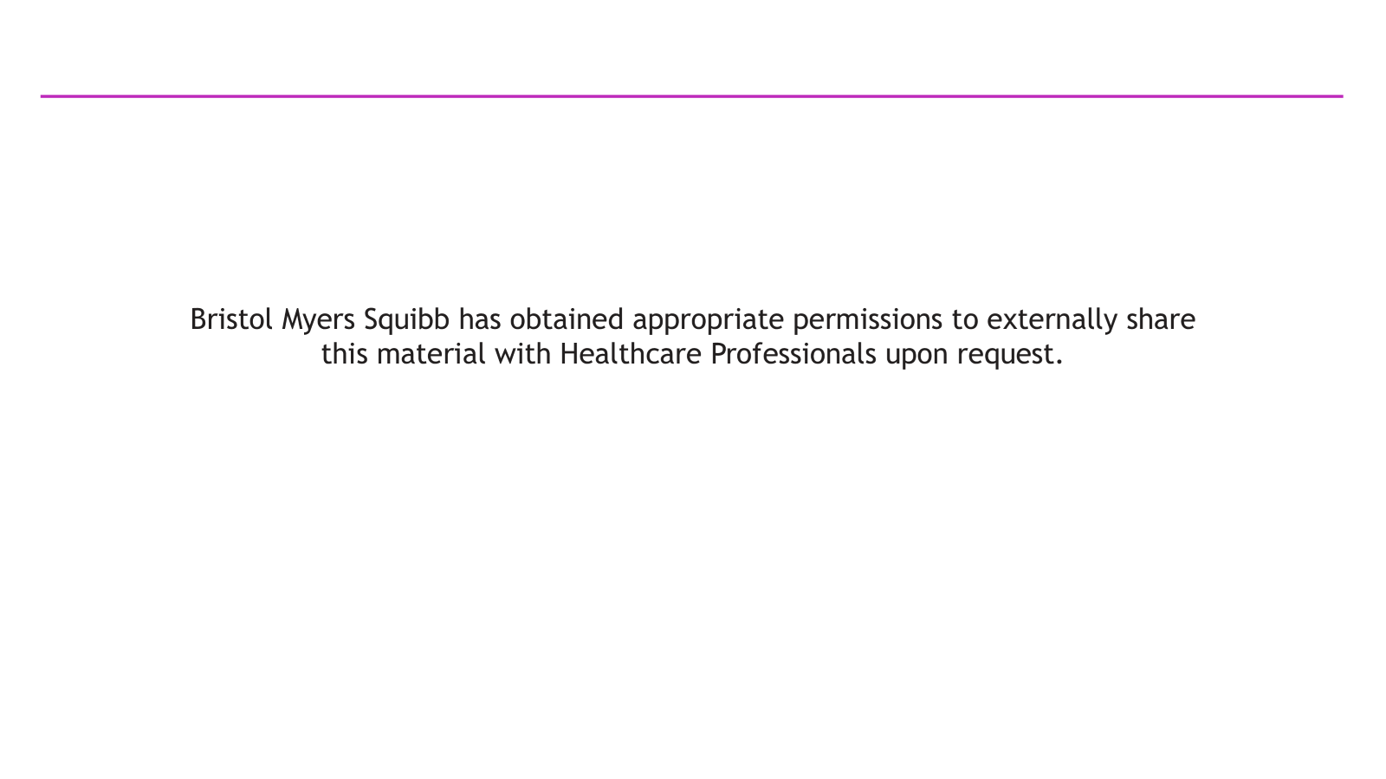

Slide 2
PANKU-Breast01: Randomized Phase III Study of Izalontamab Brengitecan (iza-bren) in Previously Treated Unresectable Locally Advanced or Metastatic (LA/M) Hormone Receptor-Positive/HER2-negative (HR+/HER2-) Breast Cancer (BC)
Bo Lan¹, Yehui. Shi², Xiying Shao³, Fan Wu⁴, Shusen Wang⁵, Weimin Xie⁶, Qingyuan Zhang⁷, Quchang Ouyang⁸, Jiuwei Cui⁹, Xiaoling Ling¹⁰, Haijun Yu¹¹, Huihui Li¹², Xianjun Tang¹³, Sijuan Ding¹⁴, Chunfang Hao¹⁵, Bing Zhao¹⁶, Sa Xiao¹⁷, Hai Zhu¹⁸, Yi Zhu¹⁹, Binghe Xu^{1*}
On behalf of the PANKU-Breast01 investigators
*Leading PI
¹Department of Medical Oncology, National Cancer Center/National Clinical Research Center for Cancer/Cancer Hospital, Chinese Academy of Medical Sciences and Peking Union Medical College, Beijing, China; ²Department of Breast Medical Oncology, Tianjin Medical University Cancer Institute and Hospital, Tianjin, China; ³Department of Medical Oncology for Breast Diseases, Zhejiang Cancer Hospital, Hangzhou, China; ⁴Department of Breast Medical Oncology, Fujian Cancer Hospital, Fuzhou, China; ⁵Department of Medical Oncology, Sun Yat-sen University Cancer Center, Guangzhou, China; ⁶Department of Breast, Bone & Soft Tissue Oncology, Guangxi Medical University Cancer Hospital, Nanning, China; ⁷Department of Breast Medical Oncology, Harbin Medical University Cancer Hospital, Harbin, China; ⁸Department of Breast Medical Oncology, Hunan Cancer Hospital, Changsha, China; ⁹Department of Cancer Center, The First Hospital of Jilin University, Changchun, China; ¹⁰Department of Medical Oncology, The First Hospital of Lanzhou University, Lanzhou, China; ¹¹Department of Tumor chemoradiotherapy, Zhongnan Hospital of Wuhan University, Wuhan, China; ¹²Department of Breast Medical Oncology, Cancer Hospital of Shandong First Medical University, Jinan, China; ¹³Department of Breast Oncology Center, Chongqing University Cancer Hospital, Chongqing, China; ¹⁴Department of Oncology, The Central Hospital of Yongzhou, Yongzhou, China; ¹⁵Department of Breast Tumor, Tianjin Cancer Hospital Airport Hospital, Tianjin, China; ¹⁶Department of Breast Medical Oncology, Affiliated Cancer Hospital of Xinjiang Medical University, Urumqi, China; ¹⁷Medical and Pharmacological Research Department, Baili-Bio (Chengdu) Pharmaceutical Co., Ltd., Chengdu, China; ¹⁸Department of Biometrics, SystImmune Inc., Redmond, United States of America; ¹⁹President and CSO, Sichuan Biokin Pharmaceutical Co., Ltd, Chengdu, China
23 October 2026
Notes:
Thank you for the introduction. I’d like to thank the organizing​ committee for this invitation. On behalf of my co-investigators, it is my honor to present the results​ from the PANKU-BREAST-01: Randomized Phase III Study of iza-bren in Previously Treated Unresectable Locally Advanced or Metastatic Hormone Receptor-Positive/HER2-negative Breast Cancer

Slide 3
Disclosure
Presenter: Bo Lan, MD
- No conflict of interest to declare.
This study was sponsored by Baili-Bio (Chengdu) Pharmaceutical Co., Ltd.
Notes:
This is my disclosure

Slide 4
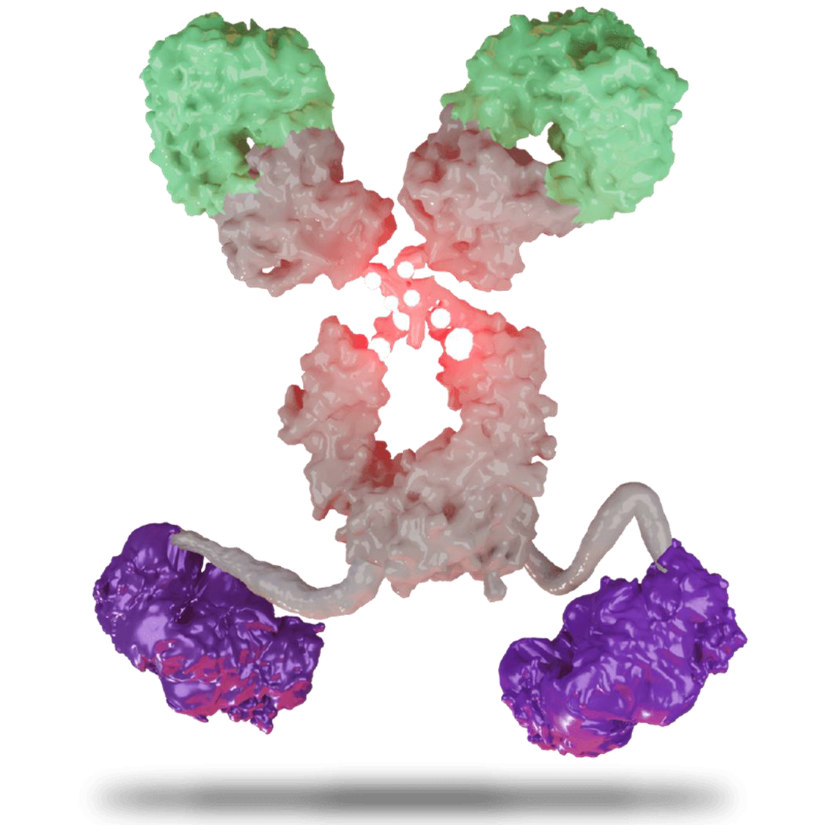
Background
Although first-line endocrine therapy plus CDK4/6 inhibitors has improved clinical outcome of HR+/ HER2- BC, patients inevitably develop resistance and clinical outcomes remain poor with subsequent therapies.
Izalontamab brengitecan (iza-bren, BL-B01D1) is a first-in-class antibody-drug conjugate (ADC) comprised of an EGFRxHER3 bispecific antibody conjugated to a novel topoisomerase I inhibitor (Ed-04) via tetrapeptide-based cleavable linker.
In previous phase I study, iza-bren showed promising antitumor activity in patients with HER2-negative, locally advanced or metastatic breast cancer (cORR, 36.4%; mPFS, 6.9 months)¹.
Iza-bren, EGFR×HER3 bispecific ADC
αEGFR
Human EGFR
Affinity: High
DAR = 8
Cat B cleavable linker
Ed-04 (top1i)
wt Fc IgG1
αHER3
Human HER3
Affinity: Low
Here we report the pre-specified interim analysis results from PANKU-Breast01 study, an open-label, multicenter, randomized phase III study, evaluating the efficacy and safety of iza-bren versus Treatment of Physician’s Choice (TPC) in patients with previously treated HR+/HER2- BC (BL-B01D1-306, NCT06343948).
Wt, wild type; Cat B, cathepsin B
1. Ann Oncol 2025;10(suppl_4):1–62
Bo Lan, MD
Notes:
Although first-line endocrine therapy plus CDK4/6 inhibitors has improved clinical outcome of HR+/ HER2- BC, patients inevitably develop resistance and clinical outcomes remain poor. iza-bren is a first-in-class ADC comprised of an EGFRxHER3 bispecific antibody conjugated to a novel topo I inhibitor (Ed-04) via tetrapeptide-based cleavable linker. In previous phase I study, iza-bren showed promising antitumor activity in patients with HER2-negative metastatic breast cancer. Here we report the pre-specified interim analysis results from PANKU-Breast01 study, an open-label, multicenter, randomized phase III study, evaluating the efficacy and safety of iza-bren versus Treatment of Physician’s Choice (TPC) in patients with previously treated HR+/HER2- BC

Slide 5
PANKU-Breast01 Study Design
An open-label, multicenter, randomized, phase III study conducted at 72 study centers across China
Key eligibility criteria
Unresectable LA/M HR+/HER2- BC (HR+, ER≥1% and/or PR≥1%; HER2-, IHC 0, IHC 1+, or IHC 2+/ISH-)
Progressed after at least 1 line of endocrine therapy
1 or 2 lines of prior chemotherapy
Previously received CDK4/6 inhibitors and taxanes
Measurable lesion per RECIST v1.1
ECOG PS 0-1
Iza-bren
2.5 mg/kg D1D8 Q3W
Primary endpoint: PFS (BICR)
Key secondary endpoint: OS
R 1:1
N=383
H_{PFS}
α=0.025
H_{OS}
α=0
TPC
Eribulin, D1D8 Q3W
Capecitabine, BID, Q3W
Gemcitabine, D1D8 Q3W
Vinorelbine, D1D8 Q3W
Other secondary endpoints
Stratified by
Previous lines of chemotherapy (1 line vs 2 lines)
CNS metastases (Yes vs No)
HER2 expression (IHC 0 vs IHC 1+ vs IHC 2+/ISH-)
    PFS (INV)
    ORR (BICR & INV)
    DCR (BICR & INV)
    DOR (BICR & INV)
    Safety, PK, Immunogenicity
Treatment until
Disease progression per RECIST v1.1 or intolerable toxicity
Note: Iza-bren was dosed with 10% compensation per protocol; eribulin 1.4 mg/m² on days 1 and 8 Q3W; capecitabine 1000-1250 mg/m², BID from days 1 to 14 Q3W; gemcitabine 1000 mg/m² on days 1 and 8 Q3W; vinorelbine 25 mg/m² on days 1 and 8 Q3W.
ECOG PS, Eastern Cooperative Oncology Group performance status; Q3W, every 3 weeks; D, day;
PFS, progression-free survival; BICR, blinded independent central review; OS, overall survival; INV, investigator assessed; ORR, objective response rate (confirmed); DCR, disease control rate; DOR, duration of response.
Bo Lan, MD
Notes:
Here is the study design. The study was conducted at 72 centers across China. Key eligibility criteria included unresectable locally advanced or metastatic HR+/HER2- breast cancer, progressed after at least 1 line of endocrine therapy, 1 or 2 lines of prior chemotherapy in the metastatic setting, previously received CDK4/6 inhibitors and taxanes. Patients were randomized 1:1 to Iza-bren 2.5 mg/kg d1,d8 q3w or TPC including eribulin, capecitabine, gemcitabine and vinorelbine stratified by previous lines of chemo, CNS metastases and HER2 expression. The primary endpoint was PFS by BICR. Key secondary endpoint was OS.

Slide 6
Patient Disposition
560 Patients screened
177 Screen failure
158 Did not meet inclusion or met exclusion criteria
12 Patients withdrew informed consent
7 Patients due to other reasons
383 Patients randomized
190 Assigned to
iza-bren arm (ITT)
193 Assigned to comparator arm (ITT)
165 End of treatment
123 Progressive disease
24 Voluntarily withdrawal
4 Death
4 Treatment delayed for > 28 days
3 Adverse events
2 Investigator’s decision
2 Initiation of new anti-cancer therapy
3 Other
190 Treated with
iza-bren (mITT)
193 Treated with TPC (mITT)
185 End of treatment
164 Progressive disease
15 Voluntarily withdrawal
3 Investigator’s decision
2 Death
1 Adverse events
25 Treatment ongoing
8 Treatment ongoing
Data cut off: July 21, 2026
Bo Lan, MD
Notes:
Here is the patient disposition, 383 patients were randomized, 190 were assigned to iza-bren, 193 were assigned to TPC. As of the data cut off, 25 were still receiving iza-bren and 8 were receiving TPC.

Slide 7
Baseline Characteristics
 | Iza-bren (N = 190) | TPC (N = 193)
Median (range) age, years | 54.0 (33.0, 71.0) | 54.0 (27.0, 70.0)
Age group (years), n (%)
< 65 | 166 (87.4) | 172 (89.1)
≥ 65 | 24 (12.6) | 21 (10.9)
Previous chemotherapy lines, n (%)
1 line | 135 (71.1) | 139 (72.0)
2 lines | 55 (28.9) | 54 (28.0)
CNS metastases, n (%)
Yes | 4 (2.1) | 3 (1.6)
No | 186 (97.9) | 190 (98.4)
HER2 expression, n (%)
IHC 0 | 64 (33.7) | 66 (34.2)
IHC 1+ | 73 (38.4) | 74 (38.3)
IHC 2+/ISH- | 53 (27.9) | 53 (27.5)
 | Iza-bren (N = 190) | TPC (N = 193)
Duration of prior CDK-inhibitor use ≥ 12 months, n (%) | 93 (48.9) | 103 (53.4)
Prior (neo)adjuvant therapy, n (%) | 152 (80.0) | 149 (77.2)
Prior anthracycline use, n (%) | 152 (80.0) | 160 (82.9)
Duration of endocrine therapy in advanced disease ≥ 6 months, n (%) | 162 (85.3) | 164 (85.0)
Progression within 6 months after (neo)adjuvant chemotherapy, n (%) | 16 (8.4) | 18 (9.3)
Baseline liver metastasis, n (%) | 136 (71.6) | 137 (71.0)
ECOG PS, n (%)
0 | 68 (35.8) | 69 (35.8)
1 | 122 (64.2) | 124 (64.2)
De novo metastasis at initial diagnosis, n (%) | 33 (17.4) | 42 (21.8)
Previous radiotherapy, n (%) | 106 (55.8) | 103 (53.4)
Data cut off: July 21, 2026
Bo Lan, MD
Notes:
The baseline characteristics were well balanced between the two groups. Median age was 54. Over 70% had received previous 1 line of chemo, about one third were HER2 zero, and over 70% had liver metastasis.

Slide 8
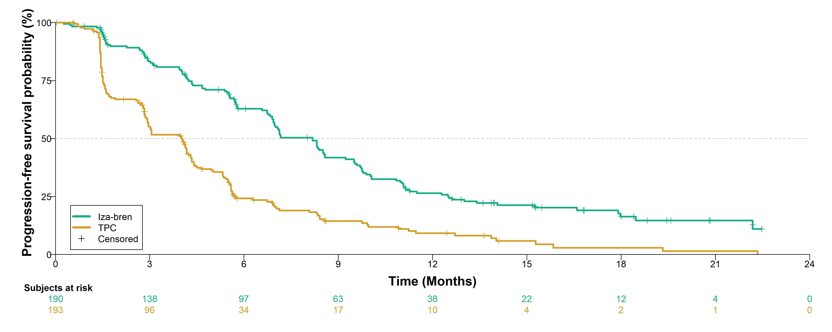
PFS by BICR: Primary Endpoint
 | Iza-bren (N = 190) | TPC (N = 193)
Number of events | 130 | 159
Median, mo (95% CI) | 8.2 (6.9, 8.6) | 4.0 (2.9, 4.3)
HR (95% CI) | 0.41 (0.33, 0.53)†
P-value | <0.0001*
62.8%
41.8%
24.2%
26.5%
14.4%
9.2%
Iza-bren demonstrated a statistically significant and clinically meaningful improvement in PFS vs TPC with doubling of mPFS and a HR of 0.41
PFS (BICR) was evaluated in the mITT population. The median duration of follow-up for PFS was 15.2 months. ITT population is identical to the mITT population.
†Based on a stratified Cox regression model. *One-sided, based on a stratified log-rank test. Stratification factor CNS metastases (yes vs no) was not included in the stratified analysis due to the small number of patients with CNS metastases in both arms (n=4 or 3).
Data cut off: July 21, 2026
Bo Lan, MD
Notes:
For the primary endpoint PFS by BICR, Iza-bren achieved a median PFS of 8.2 months, compared to 4 months with TPC. Iza-bren demonstrated a statistically significant and clinically meaningful improvement in PFS vs TPC with doubling of mPFS and a HR of 0.41, p-value was less than 0.0001.

Slide 9
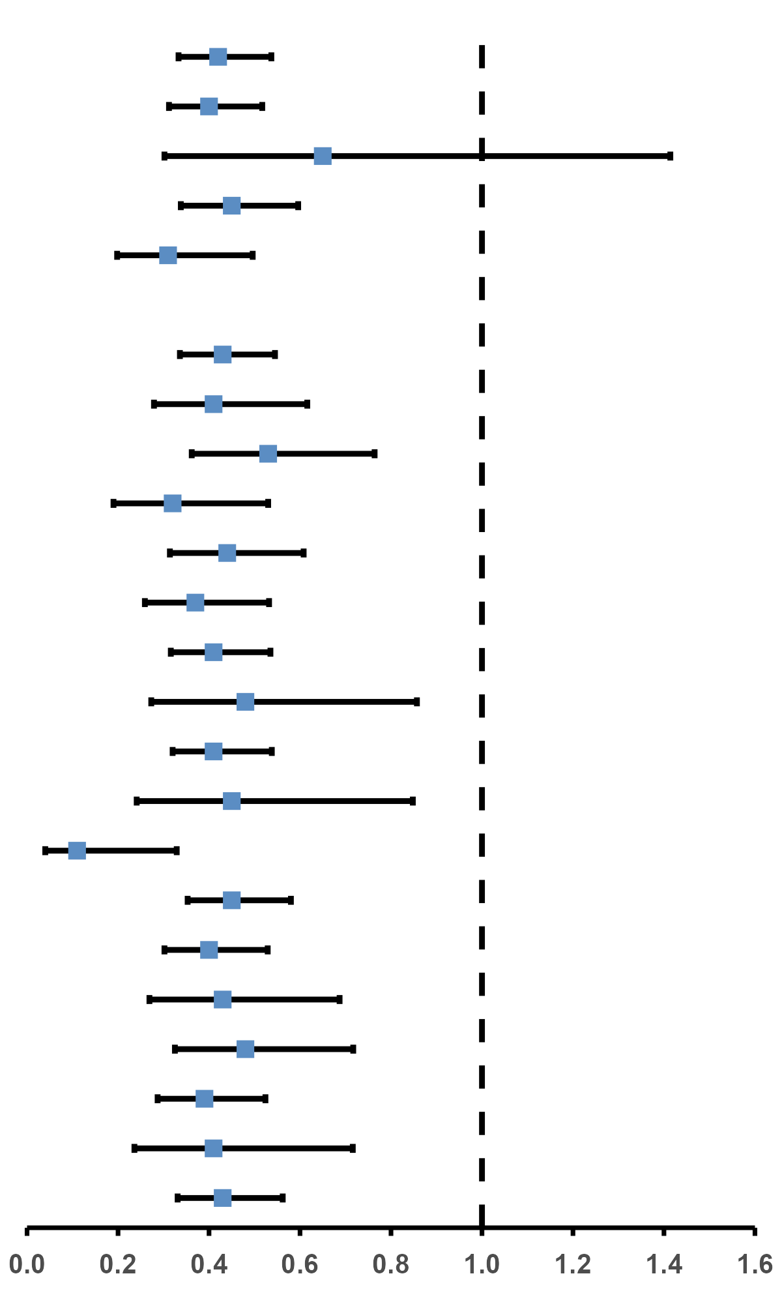
Subgroup Analysis of PFS (BICR)
Category | Subgroup | Iza-bren | TPC |  | Hazard Ratio (95% CI)
 |  | Events/n | Events/n
All subjects |  | 130/190 | 159/193 |  | 0.42 (0.33, 0.54)
Age group | <65 years | 113/166 | 146/172 |  | 0.40 (0.31, 0.52)
 | ≥65 years | 17/24 | 13/21 |  | 0.65 (0.30, 1.41)
Previous chemotherapy lines | 1 line | 90/135 | 113/139 |  | 0.45 (0.34, 0.60)
 | 2 lines | 40/55 | 46/54 |  | 0.31 (0.20, 0.50)
CNS metastases | Yes | 3/4 | 3/3 |  | -
 | No | 127/186 | 156/190 |  | 0.43 (0.34, 0.54)
HER2 expression | IHC 0 | 47/64 | 58/66 |  | 0.41 (0.28, 0.62)
 | IHC 1+ | 54/73 | 61/74 |  | 0.53 (0.36, 0.76)
 | IHC 2+/ISH- | 29/53 | 40/53 |  | 0.32 (0.19, 0.53)
Duration of prior CDK-inhibitor use ≥ 12 months | Yes | 62/93 | 88/103 |  | 0.44 (0.31, 0.61)
 | No | 67/96 | 71/90 |  | 0.37 (0.26, 0.53)
Prior anthracycline use | Yes | 104/152 | 133/160 |  | 0.41 (0.32, 0.54)
 | No | 26/38 | 26/33 |  | 0.48 (0.27, 0.86)
Duration of endocrine therapy in advanced disease ≥ 6 months | Yes | 109/162 | 134/164 |  | 0.41 (0.32, 0.54)
 | No | 21/28 | 25/29 |  | 0.45 (0.24, 0.86)
Progression within 6 months after (neo)adjuvant chemotherapy | Yes | 9/16 | 16/18 |  | 0.11 (0.04, 0.33)
 | No | 121/174 | 143/175 |  | 0.45 (0.35, 0.58)
Baseline liver metastasis | Yes | 97/136 | 115/137 |  | 0.40 (0.30, 0.53)
 | No | 33/54 | 44/56 |  | 0.43 (0.27, 0.69)
ECOG PS | 0 | 47/68 | 57/69 |  | 0.48 (0.33, 0.72)
 | 1 | 83/122 | 102/124 |  | 0.39 (0.29, 0.52)
Whether stage IV at initial diagnosis | Yes | 21/33 | 36/42 |  | 0.41 (0.24, 0.72)
 | No | 109/157 | 123/151 |  | 0.43 (0.33, 0.56)
Iza-bren better
TPC better
Consistent PFS benefit was seen across all subgroups.
Data cut off: July 21, 2026
Bo Lan, MD
Notes:
Consistent PFS benefit was seen across all subgroups, regardless of previous chemotherapy lines, HER2 expression, duration of prior CDK4/6 inhibits, or liver metastases

Slide 10
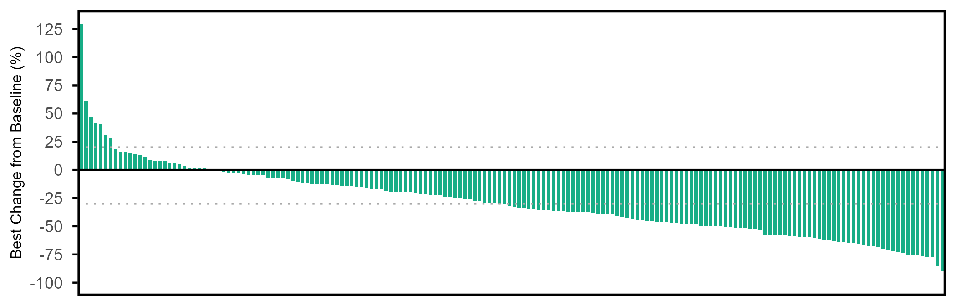
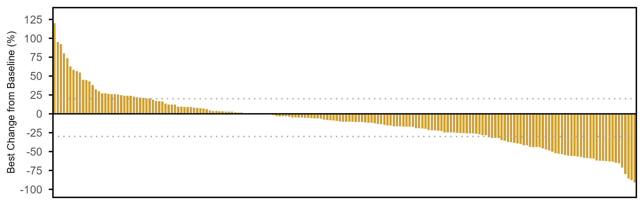
Antitumor Responses
 | Iza-bren (N=190) | TPC (N=193)
Best overall response, n (%)
PR | 77 (40.5) | 39 (20.2)
Non-CR/Non-PD | 3 (1.6) | 3 (1.6)
SD | 84 (44.2) | 81 (42.0)
PD | 16 (8.4) | 61 (31.6)
NE | 10 (5.3) | 9 (4.7)
ORR, % (95% CI) | 40.5 (33.5, 47.9) | 20.2 (14.8, 26.6)
Difference, % (95% CI) | 20.2 (11.2, 29.0)
Odds ratio (95% CI) | 2.7 (1.7, 4.3)
DCR, % (95% CI) | 86.3 (80.6, 90.9) | 63.7 (56.5, 70.5)
Iza-bren
mDOR = 6.9 mo
77.9% of patients (148/190) had tumor shrinkage and the median (range) shrinkage (%) was -37.4 (-89.9, -0.1).
TPC
mDOR = 4.2 mo
CR, complete response; PR, partial response; SD, stable disease; PD, progressive disease; NE, not evaluable
60.6% of patients (117/193) had tumor shrinkage and the median (range) shrinkage (%) was -24.5 (-90.7, -0.1).
OS data not mature*: Median follow-up 17.8 months, and no detrimental effect was observed
The study is continuing to the next planned analysis for OS
*: Information fraction: 62.8%
BICR-assessed confirmed ORR was doubled in iza-bren versus TPC with longer durability of response.
Data cut off: July 21, 2026
Bo Lan, MD
Notes:
Regarding antitumor responses, Iza-bren achieved an ORR of 40.5%, compared to 20.2% for TPC. mDOR was 6.9 months for Iza-bren and 4.2 months for TPC. BICR assessed confirmed ORR was doubled in iza-bren versus TPC with longer duration of response. OS data was not mature, no detrimental effect was observed. The study is continuing to the next planned analysis for OS.

Slide 11
Safety Summary
 | Iza-bren (N = 190) | TPC (N = 193)
TRAEs, n (%) | 189 (99.5) | 188 (97.4)
≥Grade 3 TRAEs, n (%) | 162 (85.3) | 127 (65.8)
Treatment-related SAEs, n (%) | 79 (41.6) | 22 (11.4)
TRAEs leading to death, n (%) | 2 (1.1) | 1 (0.5)
TRAEs leading to treatment discontinuation, n (%) | 3 (1.6) | 2 (1.0)
TRAEs leading to dose reduction, n (%) | 123 (64.7) | 55 (28.5)
TRAEs leading to dose interruption, n (%) | 107 (56.3) | 73 (37.8)
Median (range) duration of treatment, mo:
  Iza-bren: 7.3 (0.3, 22.5)
  TPC: 4.3 (0.3, 26.0)
Median (range) number of treatment cycles:
  Iza-bren: 10 (1, 30)
  TPC: 6 (1, 37)
Iza-bren had a manageable safety profile. The rate of treatment discontinuation due to TRAEs was low (1.6%) vs TPC (1.0%).
TRAEs leading to death occurred in 2 patients (1.1%) receiving iza-bren and in 1 patient (0.5%) receiving TPC.
TRAE, treatment related adverse events.
Safety data based on the safety analysis set.
TRAEs leading to death occurred in 2 patients (1.1%) receiving iza-bren: Death (unknown cause) and Pneumonia.
TRAEs leading to death occurred in 1 patient (0.5%) receiving TPC: Sepsis.
Data cut off: July 21, 2026
Bo Lan, MD
Notes:
Turning to the safety summary, Iza-bren had more Grade 3 or higher TRAEs compared to TPC. However, the median duration of treatment was longer, 7.3 months for Iza-bren and 4.3 months for TPC. Iza-bren had a manageable safety profile. The rate of treatment discontinuation due to TRAEs was low, 1.6% for Iza-bren, 1% for TPC. TRAEs leading to death occurred in 2 patients receiving iza-bren and in 1 patient receiving TPC.

Slide 12
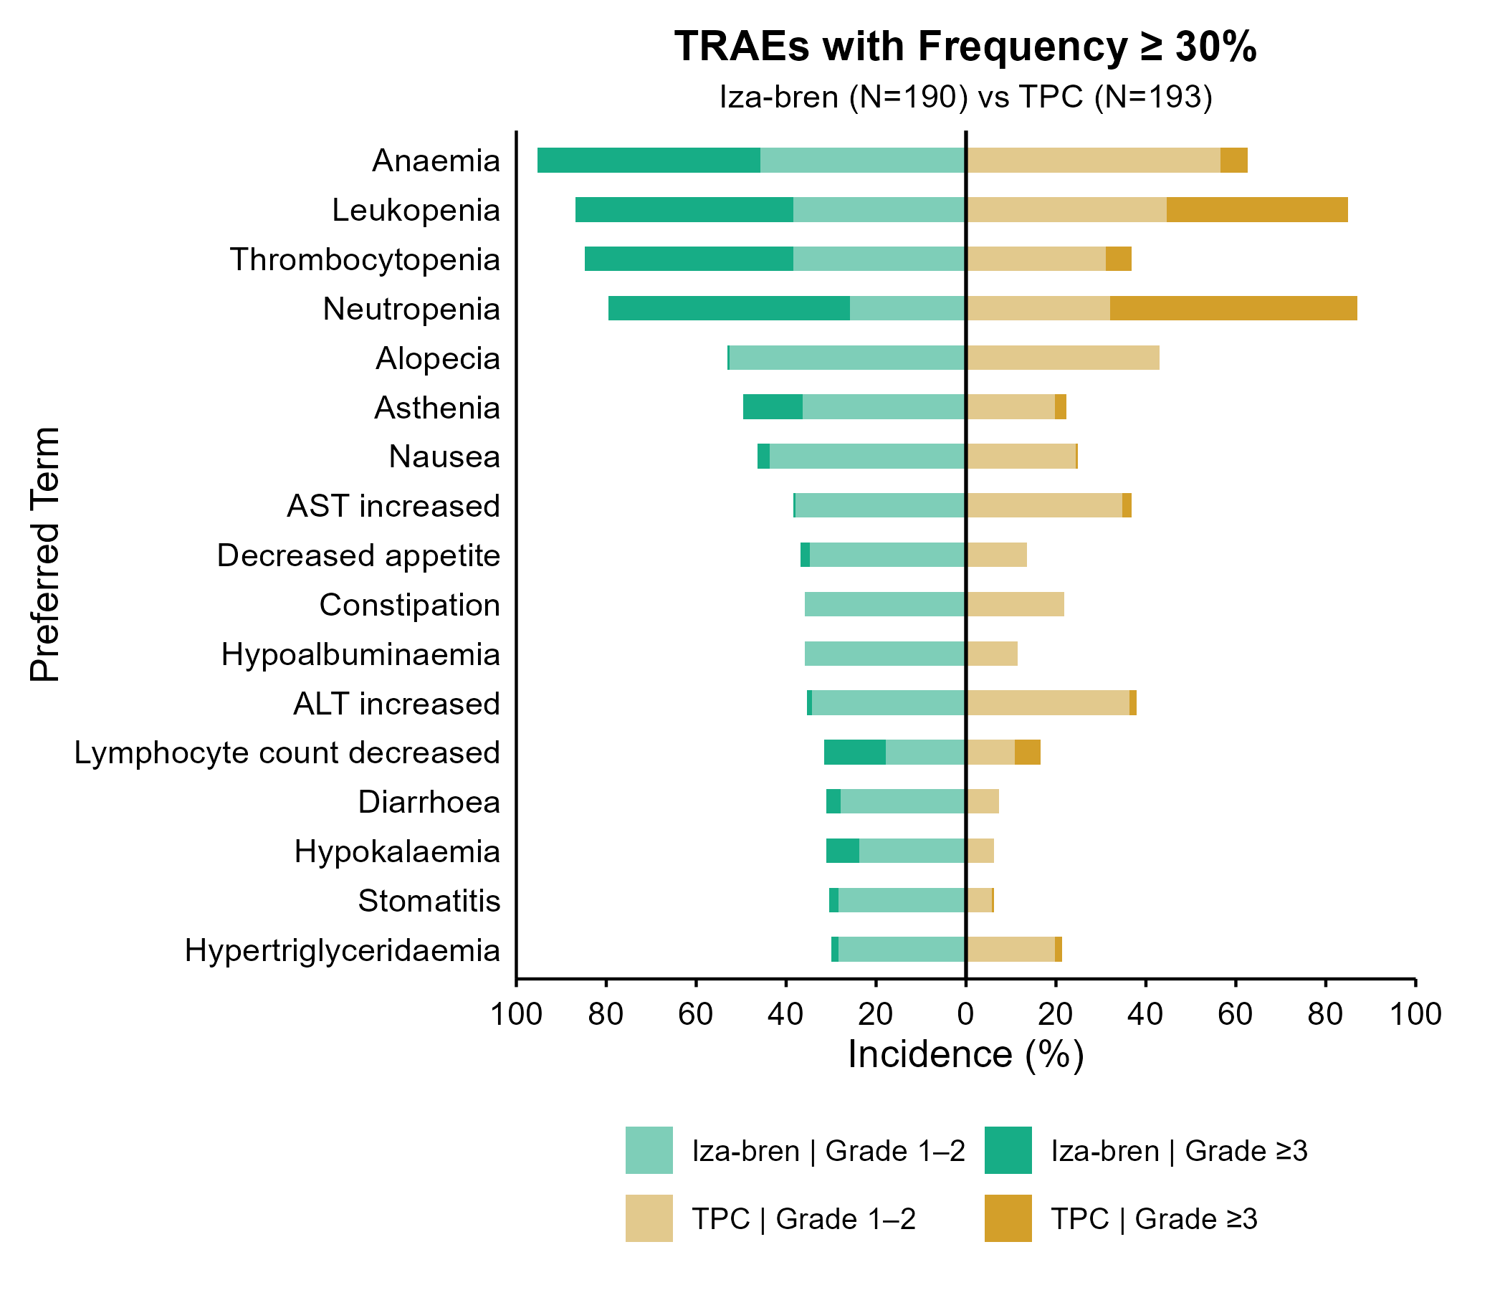
TRAEs in ≥ 30% of Patients
Most common TRAEs were hematological, including anemia, thrombocytopenia and neutropenia, which were effectively managed through standard supportive measures including growth factor support, dose delay and dose reductions, which allowed majority of patients to continue iza-bren treatment with low discontinuation rate.
Primary G-CSF prophylaxis is not mandatory.
Grade ≥3 anemia resolved in a median of 6 days in the iza-bren arm.
Grade ≥3 neutropenia and thrombocytopenia generally resolved within 2 and 3 days in the iza-bren arm.
Neutropenic fever (7.9%) and grade 3 or higher infections (4.7%) were low in the iza-bren arm.
Non-hematologic AEs were mostly low grade; alopecia was the most common in both groups (53.2% with iza-bren and 43.0% with TPC), followed by asthenia (49.5% and 22.3%, respectively).
Adjudicated treatment-related ILD occurred in two patients (1.1%) in the iza-bren arm (one case of grade 1 and one case of grade 2). None in the TPC arm.
49.5
44.8
56.5
6.2
48.4
38.4
44.6
40.4
46.3
38.4
31.1
5.7
53.7
25.8
32.1
54.9
0.5
52.7
43.0
13.2
36.3
19.7
2.6
2.6
43.7
24.4
0.5
0.5
37.9
34.7
2.1
2.1
34.7
13.5
35.8
21.8
35.8
11.4
1.1
34.2
36.2
1.6
13.7
17.9
10.9
5.7
3.2
27.9
7.3
7.4
23.7
6.2
2.1
28.4
5.7
0.5
1.6
28.4
19.6
1.6
Data cut off: July 21, 2026
Bo Lan, MD
Notes:
Most common TRAEs were hematological, including anemia, thrombocytopenia and neutropenia, which were effectively managed through standard supportive measures. Non-hematologic AEs were mostly low grade. Treatment-related ILD occurred in two patients (1.1%) in the iza-bren arm (one case of grade 1 and one case of grade 2).

Slide 13
Conclusions
In this pre-specified analysis, iza-bren demonstrated a statistically significant and clinically meaningful improvement in PFS vs TPC in previously treated HR+/HER2- BC, meeting the primary endpoint.
Iza-bren demonstrated an improved confirmed ORR and more durable response than TPC.
  OS is immature at this interim analysis, no detrimental effect was observed.
The safety profile of iza-bren was manageable and consistent with previous studies.
  TRAEs leading to discontinuation (1.6%) were low.
  The incidence of adjudicated ILD was 1.1%
The results support iza-bren as a potential new standard of care option in this population.
Bo Lan, MD
Notes:
For conclusion, In this pre-specified analysis, iza-bren demonstrated a statistically significant and clinically meaningful improvement in PFS vs TPC in previously treated HR+/HER2- BC, meeting the primary endpoint. Median PFS was 8.2 months for Iza-bren and 4 months for TPC, HR was 0.41. Iza-bren demonstrated an improved confirmed ORR and more durable response than TPC. OS is immature at this interim analysis, no detrimental effect was observed. The safety profile of iza-bren was manageable and consistent with previous studies. TRAEs leading to discontinuation (1.6%) were low. The incidence of adjudicated ILD was 1.1%. The results support iza-bren as a potential new standard of care option in this population.

Slide 14
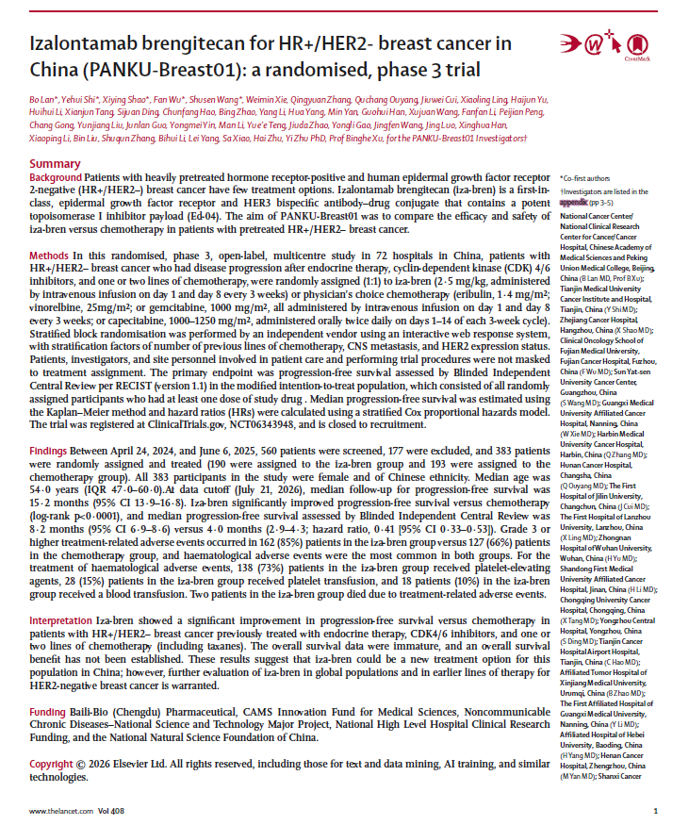


Publication
https://doi.org/10.1016/S0140-6736(26)02096-9
Bo Lan, MD

Slide 15
Acknowledgments
Sincere appreciation to all patients who participated in this study, their families, and their caregivers.
Special thanks to leading PI, Prof Binghe Xu, all other investigators, and all team members in this study.
Thank 2026 ESMO Congress Organization Committee.
Bo Lan, MD
Notes:
Sincere appreciation to all patients who participated in this study, their families, and their caregivers. Special thanks to leading PI, Prof Binghe Xu, all other investigators, and all team members in this study. Thank you to the Organization Committee. Thanks for your attention.

