Slide 1
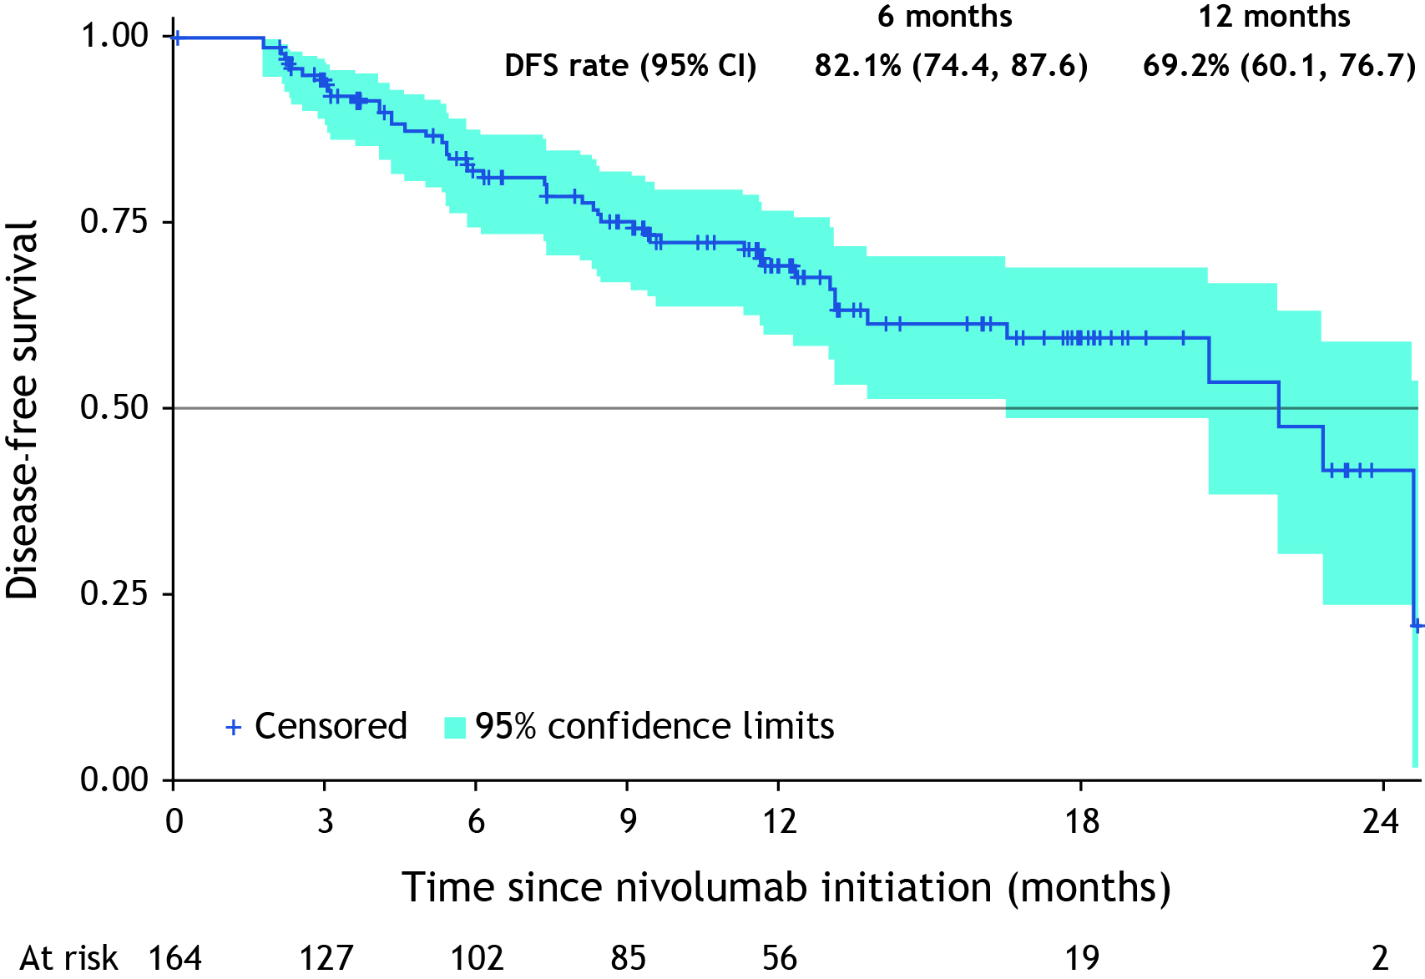

Real-world outcomes of adjuvant nivolumab in patients with localized muscle invasive urothelial carcinoma: the ambispective URADJ study
4807eP
Y. Neuzillet¹, C. Thibault², G. Pignot³, M. Gross-Goupil⁴, R. Kokorian⁵, A. Moreira⁶, G. Petit⁷, S. Néré⁷, M. Rouprêt⁸, P. Barthélémy⁹
¹Department of Urology, Foch Hospital, Suresnes, France; ²Medical Oncology Department, Georges Pompidou European Hospital (HEGP), Paris, France; ³Department of Oncologic Surgery, IPC-Institut Paoli-Calmettes, Marseille, France; ⁴Department of Medical Oncology, University Hospital Bordeaux, Bordeaux, France;
⁵Department of Medical Oncology, Clinique Mathilde, Rouen, France; ⁶Department of Medical Oncology, University Hospital of Amiens, Amiens, France; ⁷Medical Department, Bristol Myers Squibb, Rueil-Malmaison, France; ⁸Department of Urology, Pitié-Salpêtrière Hospital, Paris, France; ⁹Medical Oncology Department, Strasbourg Europe Cancer Institute, Strasbourg, France*.
* Affiliation at the time the study was conducted and the data were analyzed.
Background
Key Figure and Conclusions
Results (cont.)
Nivolumab is a monoclonal antibody directed against programmed cell death protein 1 (PD-1) used to treat patients with muscle-invasive urothelial carcinoma (MIUC).¹
Based on the disease-free survival (DFS) benefit and favorable safety profile demonstrated in the CheckMate 274 trial, nivolumab monotherapy became the first immune-oncology-based therapy approved in the adjuvant setting in patients at high risk of recurrence after resection (tumor cell programmed death-ligand 1 [PD-L1] expression ≥1%).^{2,3,4}
Following approval of nivolumab for patients with MIUC and tumor cell PD-L1 ≥1% by the European Commission on 1 April 2022,⁵ it was important to assess how nivolumab would impact MIUC management in France.
We report the largest real-world dataset assessing the effectiveness and safety of adjuvant nivolumab administered in an unselected French population in routine clinical practice.
Key Figure A. Disease-free survival since initiation of nivolumab
Table 1. Demographics and clinical characteristics at nivolumab initiation
Table 2. Previous radical surgery
In this largest French real-world cohort of patients with MIUC and tumor cell PD-L1 ≥1% receiving adjuvant nivolumab, DFS outcomes were consistent with those reported in CheckMate 274^{2,3,4} and no new safety signals were identified.
 | FAS (N=164)
Male sex, n (%) | 125 (76.2)
Age, median (range), years | 70 (39–89)
ECOG PS, n (%) 0 1 ≥2 | n=161 72 (44.7) 71 (44.1) 18 (11.2)
Tumor origin at initial diagnosis, n (%) Bladder Upper tract disease Renal pelvis Ureter Other | 146 (89.0) 28 (17.1) 5 (3.0) 23 (14.0) 3 (1.8)
Material used for PD-L1 testing, n (%) TURBT Radical surgery | n=159 52 (32.7) 107 (67.3)
PD-L1 expression level (TC scoring), n (%) <10% ≥10% Missing | 55 (33.5) 97 (59.1) 12 (7.3)
Prior neoadjuvant systemic treatment, n (%) Cisplatin-based regimen | 68 (41.5) 63 (92.6)
Tumor stage post radical surgery with neoadjuvant systemic treatment, n (%) ypT0-1 N1-2 ypT2 N0 ypT2 N1-3 ypT3 N0 ypT3 N1-3 ypT4 N0 ypT4 N1-2 Other | n=65 6 (9.2) 18 (27.7) 7 (10.8) 19 (29.2) 8 (12.3) 3 (4.6) 2 (3.1) 2 (3.1)
Tumor stage post radical surgery without neoadjuvant systemic treatment, n (%) pTx-2 Nx-0 pTx-2 N1-3 pT3 Nx-0 pT3 N1-2 pT4 Nx-0 pT4 N1-2 Other | n=87 3 (3.4) 10 (11.5) 42 (48.3) 17 (19.5) 6 (6.9) 7 (8.0) 2 (2.3)
Main comorbidities at nivolumab initiation, n (%) Cardio-/cerebro-vascular diseases Diabetes Pulmonary disorders | 83 (50.6) 34 (20.7) 20 (12.2)
GFR at treatment initiation, n (%) Normal (≥60 mL/min/1.73m2) Mildly to moderately decreased (45–59 mL/min/1.73m²) Moderately to severely decreased (30–44 mL/min/1.73m²) Severely decreased (15–29 mL/min/1.73m²) Kidney failure (<15 mL/min/1.73m²) | n=160 81 (50.6) 46 (28.8) 26 (16.3) 5 (3.1) 2 (1.3)
Time from radical surgery to nivolumab initiation, n (%) ≤60 days >60–90 days >90 days | 59 (36.0) 70 (42.7) 35 (21.3)
Adjuvant nivolumab exposure, n (%) Nivolumab 240 mg Q2W Nivolumab 480 mg Q4W | 124 (75.6) 40 (24.4)
Received nivolumab >12 months, n (%) Nivolumab 240 mg Q2W Nivolumab 480 mg Q4W | 22 (13.4) 18 (14.5) 4 (10.0)
 | FAS (N=164)
Time from radical surgery to nivolumab initiation, median (range), days | 69.5 (25–464)
Type of radical surgery, n (%) Cystectomy Nephroureterectomy Both cystectomy and nephroureterectomy | 144 (87.8) 12 (7.3) 8 (4.9)
Number of lymph nodes resected, n (%) 0 1–10 >10 | n=160 12 (7.5) 95 (59.4) 53 (33.1)
Surgical margins, n (%) R0 R1 R2 | n=150 131 (87.3) 17 (11.3) 2 (1.3)
Type of urinary diversion, n (%) Bricker Neobladder Other | 113 (68.9) 30 (18.3) 21 (12.8)
Methods
URADJ (ClinicalTrials.gov identifier NCT06421311) was an ambispective observational study of patients with MIUC receiving adjuvant nivolumab in France (Figure 1).
Patients who started nivolumab between September 2022 and 31 July 2024 were included in the retrospective cohort, while those who started nivolumab after 31 July 31 2024 were recruited prospectively.
Patients were followed until death, withdrawal of consent, loss of contact, or the end of the study, whichever occurred first.
The study was terminated early; median inclusion period 8.8 months (last patient in 2 April 2025).
FAS, full analysis set; R, residual tumor classification
Previous radical surgery
Radical surgery was cystectomy (87.8%), nephro-ureterectomy (7.3%), or both (4.9%); median (range) number of lymph nodes removed was 8 (0-50); surgical margins were R0 in 87.3% (Table 2).
Clinical outcomes
The 6-month DFS rate was 82.1% (95% CI 74.4, 87.6), and the 12-month DFS rate was 69.2% (95% CI 60.1, 76.7; Key Figure A).
Distant disease recurrence (i.e., any non-local recurrence)
was observed in the bones, lung, and distant lymph nodes
(each 26.8%; n=11) and in the liver (24.4%; n=10).
Overall survival data were immature.
Safety
Overall, 44.4% of patients experienced at least one treatment-related adverse event (TRAE) and 7.9% experienced Grade 3/4 TRAEs (Table 3).
The most frequent TRAEs were pruritus (n=18), asthenia (12), diarrhea (9), hypothyroidism (7), and acute kidney injury (5).
By system organ class, skin and subcutaneous tissue disorders occurred most frequently (n=30).
One fatal TRAE occurred due to myositis.
Figure 1. URADJ study design
EXPECTED INCLUSION PERIOD: 1 YEAR
ACTUAL INCLUSION PERIOD: 8.8 MONTHS
300 PATIENTS EXPECTED
(200 retrospective + 100 prospective)
176 PATIENTS INCLUDED
(137 retrospective + 39 prospective)
Early access nivolumab
Start of the recruitment period
Early termination of the study
End of the recruitment period End of study
CI, confidence interval; DFS, disease-free survival
September 2022
31 July 2024
18 April 2025
Results
Retrospective patient data
Prospective patient data
Baseline demographic and clinical characteristics
As of April 2025 (database lock), 168 patients were included
in the SAS, of whom 164 were included in the FAS.
  Patients were enrolled by 51 active investigators.
  The median (range) follow-up period was 11.4 (0–24.8) months.
Among patients in the FAS, 76.2% were male and the mean (range) age was 69.4 (39–89) years (Table 1).
At initial diagnosis, 146 patients (89%) had bladder tumors and 28 patients (17%) had upper tract tumors.
Most patients received nivolumab 240 mg (n=124, 75.6%),
while 40 patients (24.4%) received nivolumab 480 mg.
The median (range) duration of treatment was 7.1 (0–19.6) months for nivolumab 240 mg and 7.9 (0–17.6) months for nivolumab 480 mg.
22 patients (13.4%) received nivolumab for >12 months, including 18 patients (14.5%) in the 240 mg group and 4 (10.0%) in the 480 mg group.
Previous systemic neoadjuvant treatments
Overall, 68 patients (41.5%) had received prior neoadjuvant systemic treatment, of whom 92.6% received a cisplatin-based regimen.
The most frequent neoadjuvant regimens were MVAC-based (75.7%) and gemcitabine-cisplatin (15.7%; Figure 2).
Patients who started nivolumab before the study initiation (n=137)
Patients who started nivolumab (<2 doses) after study initiation (n=39)
Patients who were included retrospectively continued to be followed up prospectively
Figure 2. Previous systemic neoadjuvant treatments
Planned study visits: D0, M3, M6, M9, M12, M18, M24, M30, M36, M48, M60
Planned minimum follow-up period: 3 years / Planned maximum follow-up period: 5 years
Actual follow-up period: 0–24.8 months
INCLUSION CRITERIA
≥18 years
Pathological evidence of MIUC (originating in bladder, ureter, or renal pelvis) at high risk of recurrence after radical resection with PD-L1 tumor cell expression ≥1% in patients who received neoadjuvant chemotherapy OR who did not receive neoadjuvant chemotherapy and who are not eligible or refusing adjuvant cisplatin chemotherapy
Provide oral informed consent to participate in the study (or express non-opposition to data collection during their lifetime for deceased patients enrolled retrospectively)
Could include patients who completed participation in an interventional trial or no longer receiving study drug (only followed-up for OS) OR enrolled in a clinical trial not evaluating an investigational drug (e.g., a trial investigating novel imaging modalities)
EXCLUSION CRITERIA
Other active or non-curatively treated malignancy within the past 5 years (except muscle-invasive urothelial carcinoma)
Enrolled in another interventional clinical trial for urothelial carcinoma
Pregnant women
Patients under guardianship
Proportion of patients (%)
Table 3. Treatment-related adverse events
n (%) | SAS (N=168)
At least one TRAE Yes No Missing | 67 (44.4) 84 (55.6) 17
At least one Grade 3 or 4 TRAE Yes No Missing | 12 (7.9) 139 (92.1) 17
At least one serious TRAE that resulted in death Yes No Missing | 1 (0.7) 150 (99.3) 17
D, day; M, month; MIUC, muscle-invasive urothelial carcinoma; OS, overall survival; PD-L1, programmed death-ligand 1.
Nivolumab was given over a 30-minute infusion as 240 mg every 2 weeks or 480 mg every
4 weeks, as per local labelling.
The primary outcome was DFS and secondary outcomes included overall survival (OS) and safety.
Efficacy analyses were conducted in the full analysis set (FAS, defined as all patients receiving ≥1 dose of nivolumab) and safety analyses were conducted in the safety analysis set (SAS, all patients receiving ≥1 dose of nivolumab and meeting inclusion criteria).
Treatment
Neoadjuvant regimen among
treated patients*
* Multiple possible answers; Gem, gemcitabine; MVAC, methotrexate, vinblastine, doxorubicin, cisplatin
ECOG PS, Eastern Cooperative Oncology Group performance status; FAS, full analysis set; GFR, glomerular filtration rate; N, regional lymph node involvement; PD-L1, programmed death-ligand 1; pT, pathological tumor; Q2W, every 2 weeks; Q4W, every 4 weeks;
TC, tumor cell; TURBT, transurethral resection of bladder tumor; y, staging after neoadjuvant systemic therapy.
SAS, safety analysis set; TRAE, treatment-related adverse event
References: 1. Barragán-Carrillo R, et al. JAMA Netw Open 2025;8:e2514427; 2. Galsky M, et al. J Clin Oncol 2025;43:15–21; 3. Galsky M, et al. Ann Oncol 2025;37:60–78; 4. Galsky M, et al. Eur Urol 2023;83:432–440; 5. Négrier S, et al. World J Urol 2025;43:202. Acknowledgements: The authors thank the patients, families and investigators who made the study possible. This study was sponsored by Bristol Myers Squibb. All authors contributed to and approved this presentation. We thank Nireshnee Ramchundar, PhD, of Springer Health+ who provided medical writing assistance, funded by Bristol Myers Squibb. Disclosures: YN: Institutional funding from Bristol Myers Squibb; Steering Committee Member for Bristol Myers Squibb; Advisory Board participation for Astellas, MSD, Pfizer, Merck, and AstraZeneca. CT: Advisory Board participation for Johnson & Johnson, Astellas, Ipsen, Pfizer, Merck, MSD, Bristol Myers Squibb, AstraZeneca, AAA, Seagen, Gilead, and Novartis; invited speaker for Amgen, Bayer, and Accord; institutional research funding from AstraZeneca. G Pignot: Personal and institutional Steering Committee Member for Bristol Myers Squibb. MGG: Advisory Board participation for AstraZeneca, Bristol Myers Squibb, Astellas, MSD, Ipsen, Eisai, Pfizer, Merck, Bayer, Janssen, Roche and Gilead; invited speaker for Bristol Myers Squibb, Astellas, Amgen, MSD, Janssen, Eisai, Merck, Bayer and Ipsen; institutional Steering Committee Member for Roche; principal investigator for studies sponsored by Pfizer, Ipsen, Gilead, Roche, Bayer, Astellas, Janssen, Bristol Myers Squibb, MSD, AstraZeneca and Exelixis. RK: Funding from Bristol Myers Squibb; Advisory Board participation for MSD, Johnson & Johnson, Pfizer, Astellas, and Bayer. AM: institution received research funding from Bristol Myers Squibb. G Petit and SN are BMS employees. MR: Advisory Board participation for Roche, Astellas, Janssen, Bayer, Intuitive, Bristol Myers Squibb, AstraZeneca, Ferring, and Curium; Chairman of CCAFU; Project Lead for the European Association of Urology. PB: Advisory Board participation for Bristol Myers Squibb, MSD, Merck, Pfizer, Ipsen, Bayer, Janssen Cilag, Astellas, Novartis, Amgen, and Gilead; invited speaker for AstraZeneca; institutional Coordinating Principal Investigator for Ipsen.
Presented at ESMO Congress 2026; 23–27 October 2026; Madrid, Spain. Email: y.neuzillet@hopital-foch.fr

