Slide 1
Three-year distant metastasis-free survival of the phase 3 NADINA trial comparing neoadjuvant nivolumab plus ipilimumab versus adjuvant nivolumab in resectable stage III melanoma
S.J. Witteveen, M.W. Lucas, A.M. Menzies, M. Lopez-Yurda, N. Maher, B.A. van de Wiel, R.P.M. Saw, W.J. van Houdt, A. Torres-Acosta, M.J. Boers-Sonderen, G.A.P. Hospers, M.S. Carlino, J.W.B. de Groot, E. Kapiteijn, K.P.M. Suijkerbuijk, P. Rutkowski, S. Sandhu, A.A.M. van der Veldt, G.V. Long*, C.U. Blank*
25 October 2026
Bristol Myers Squibb has obtained the appropriate permissions to share this material externally with Healthcare Professionals upon request​

Slide 2
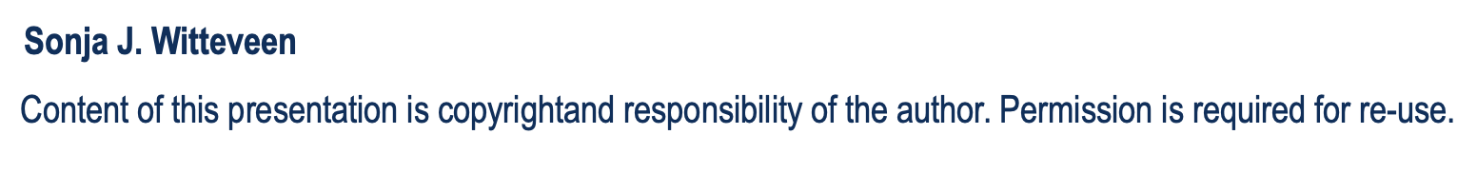
Declaration of interest
The presenter declares no personal conflicts of interest.
The NADINA trial is funded by Bristol-Myers Squibb and received additional funding in Australia from the National Health and Medical Research Council (NHMRC).

Slide 3
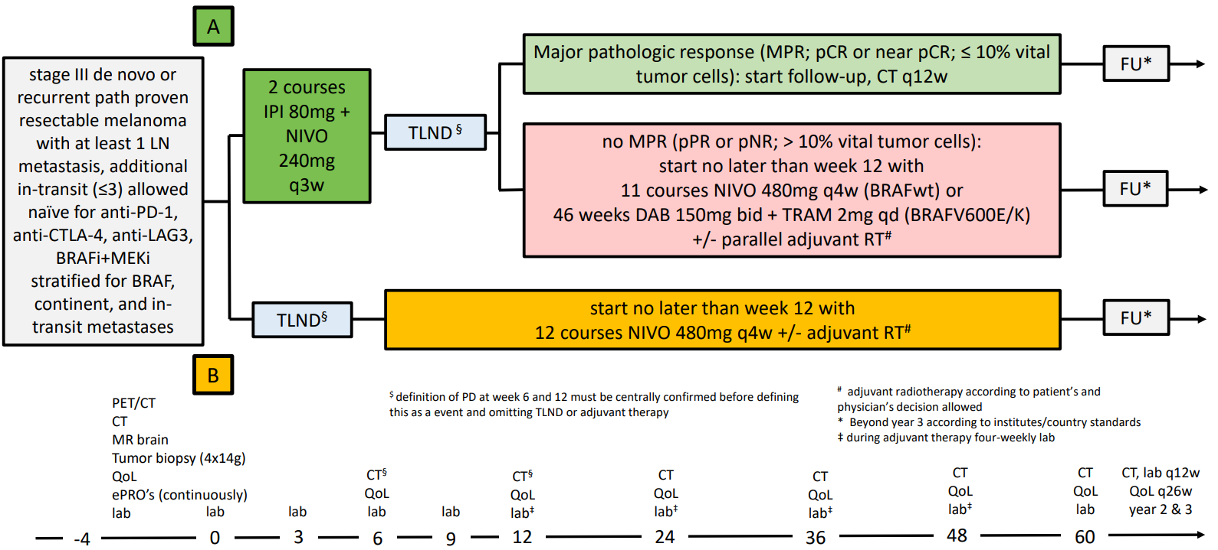
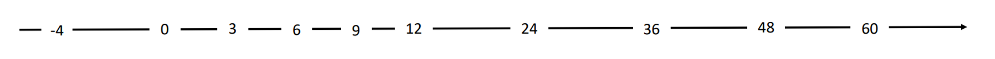
Study design of the phase 3 NADINA trial
Primary endpoint: event-free survival
Sonja J. Witteveen

Slide 4
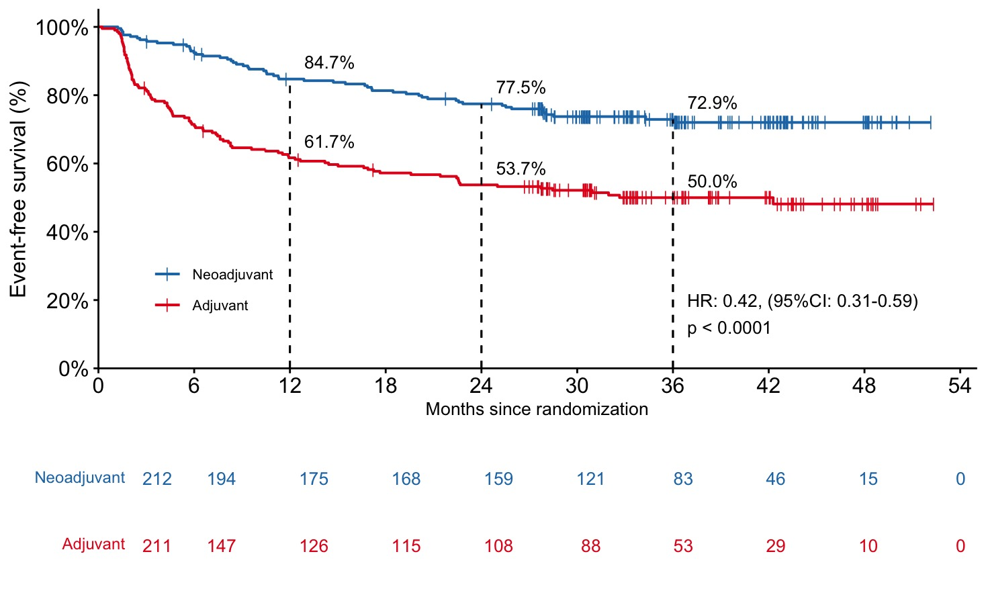
Continuous superiority for neoadjuvant over adjuvant in event-free survival
Median follow-up: 36.01 months
Sonja J. Witteveen

Slide 5
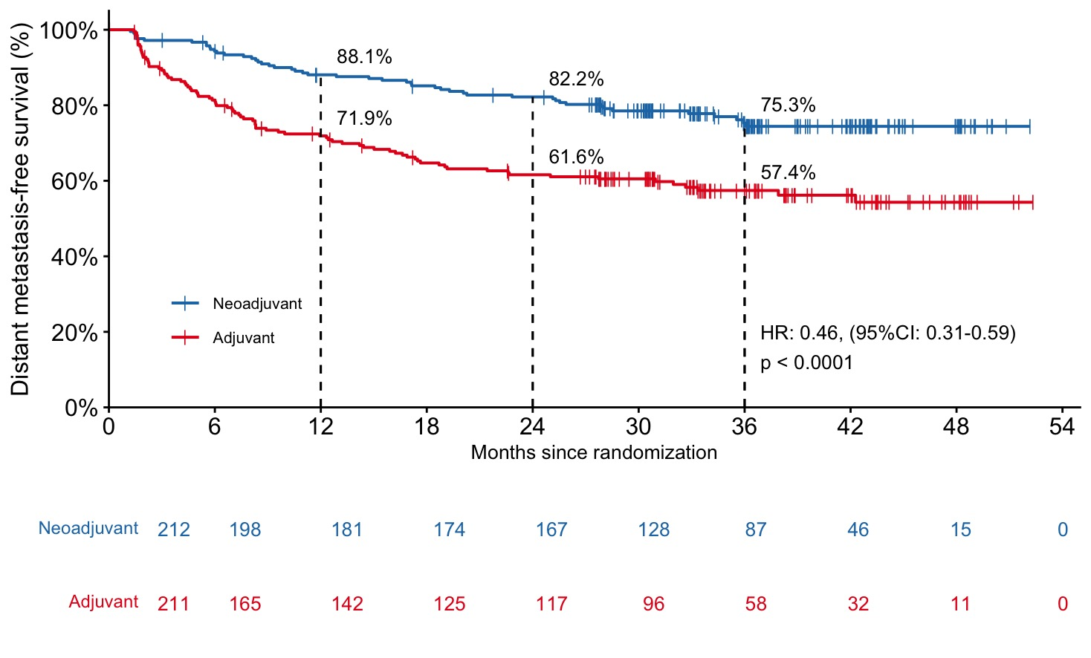
Neoadjuvant remains superior over adjuvant in distant metastasis-free survival
Sonja J. Witteveen

Slide 6
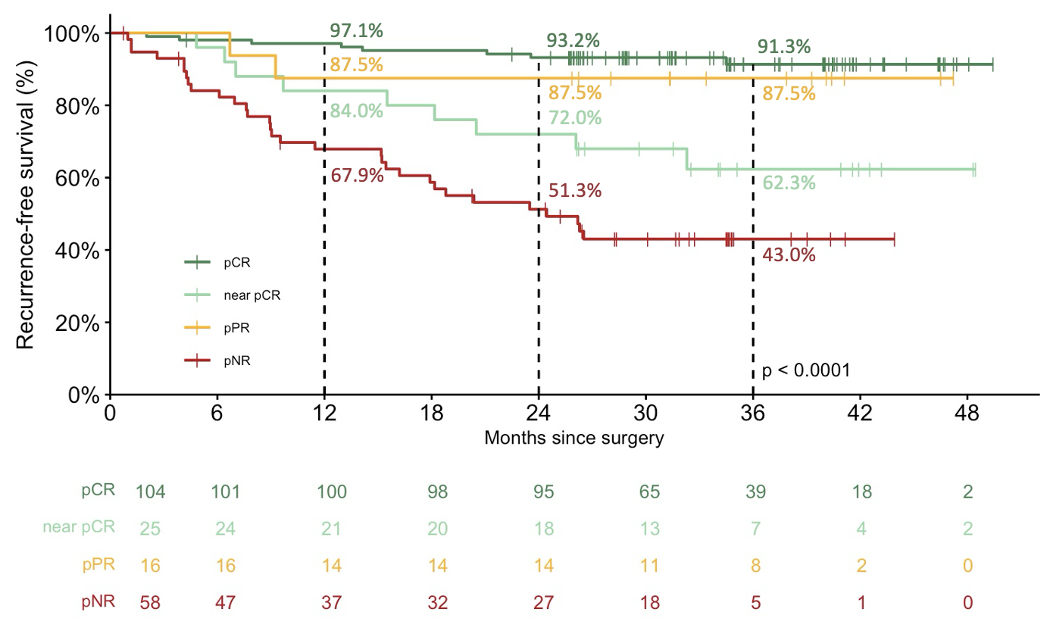
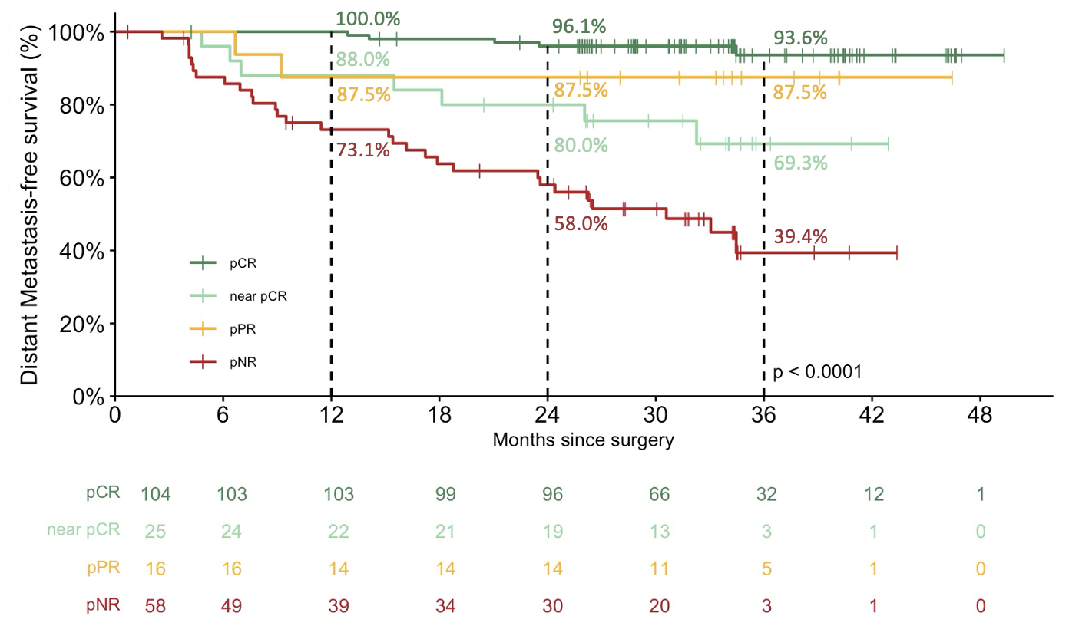
pCR has an excellent outcome in recurrence-free and distant metastasis-free survival
Recurrence-free survival
Distant metastasis-free survival
Distant metastasis-free survival is presented in this subgroup analysis as time from surgery until first distant metastasis or death due to melanoma or treatment, because the subgroups were based on pathological response which was not known before surgery.
Sonja J. Witteveen

Slide 7
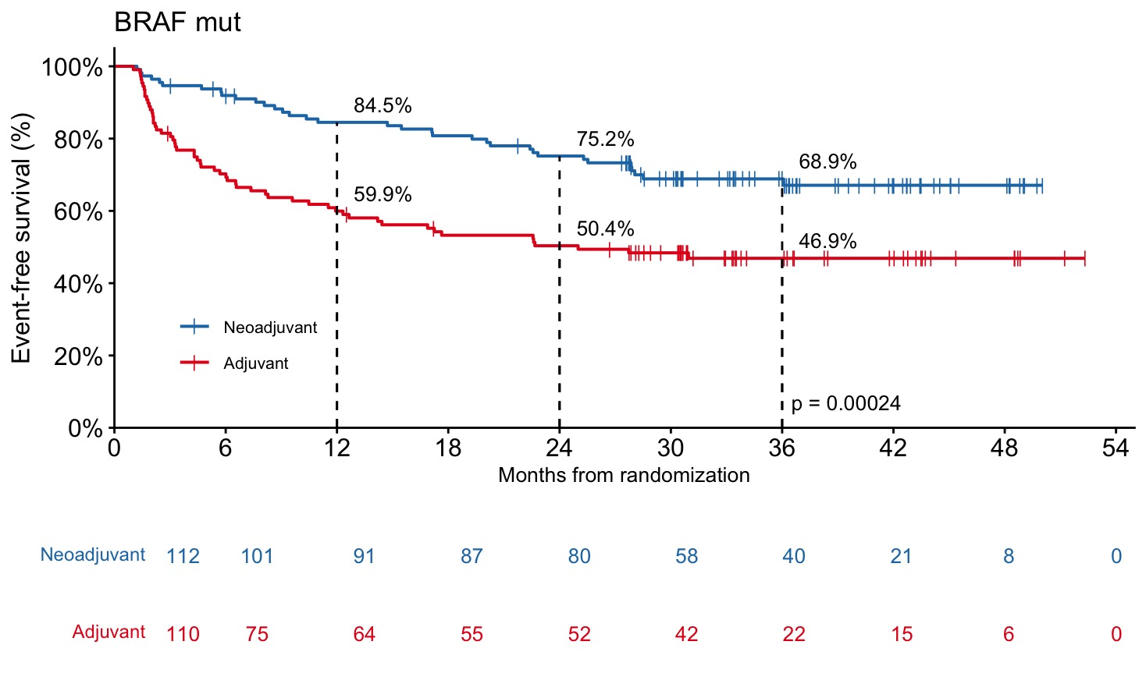
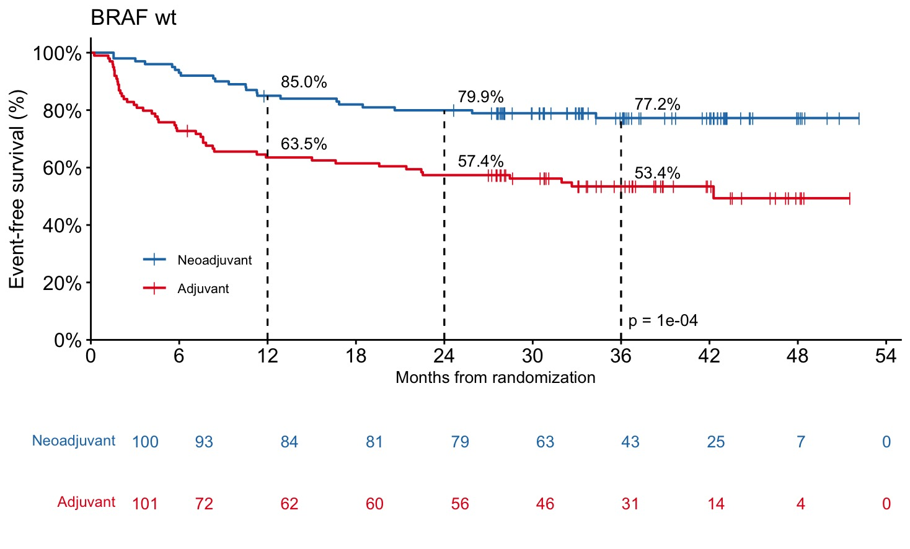
Neoadjuvant remains superior regardless of BRAF mutation status
BRAF V600E/K
BRAF wildtype & other
BRAF V600 E vs K poster #2099P
Sonja J. Witteveen

Slide 8
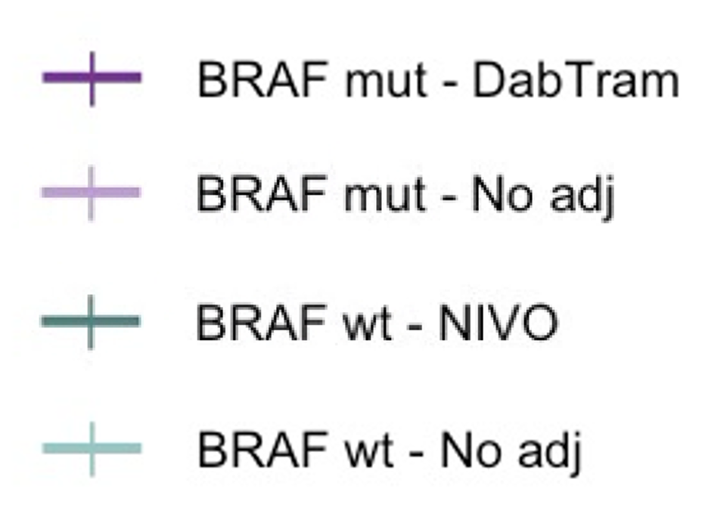
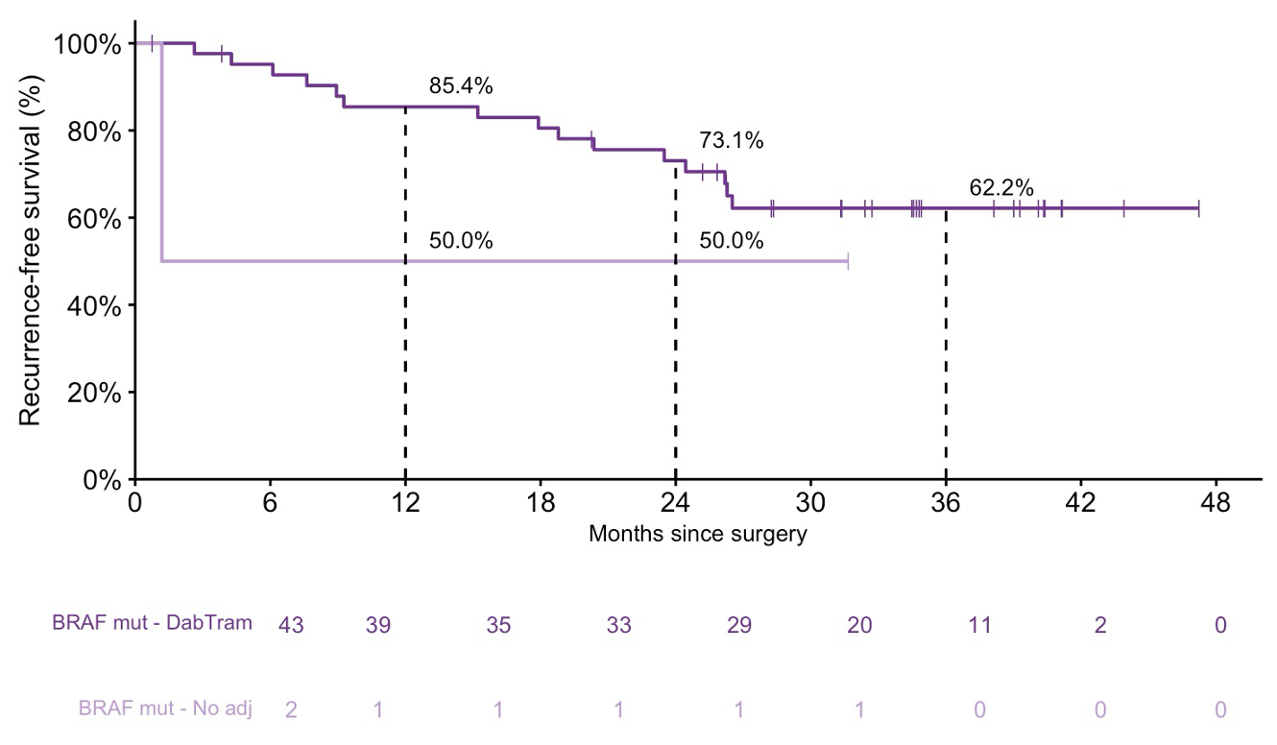
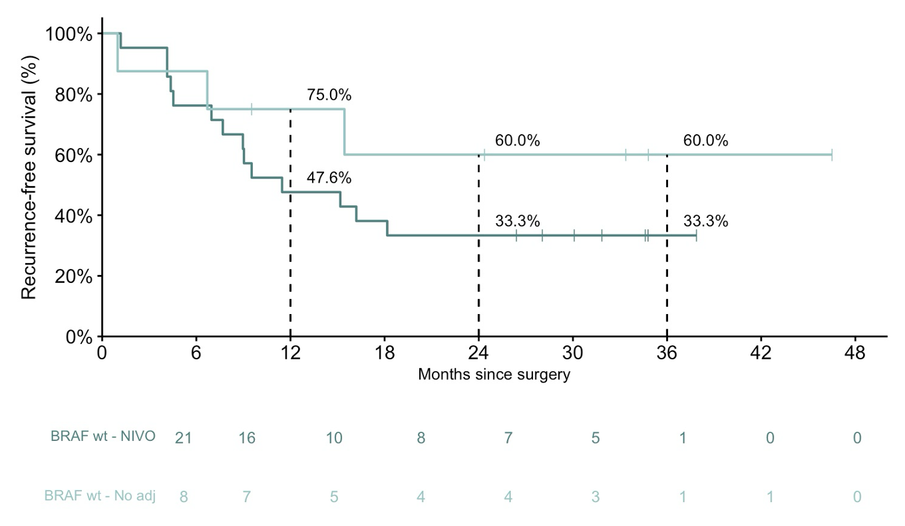
Adjuvant seems to not add clinical benefit in non-MPR patients
Recurrence-free survival - BRAF V600E/K
Recurrence-free survival - BRAF wildtype & other
In the neoadjuvant arm, patients with pPR or pNR were intended to receive adjuvant Dabrafenib + Trametinib (Dab/Tram) in case of a BRAF^{V600E/K} mutated melanoma or adjuvant nivolumab in case of BRAF wildtype melanoma or a rare mutation.
Sonja J. Witteveen

Slide 9
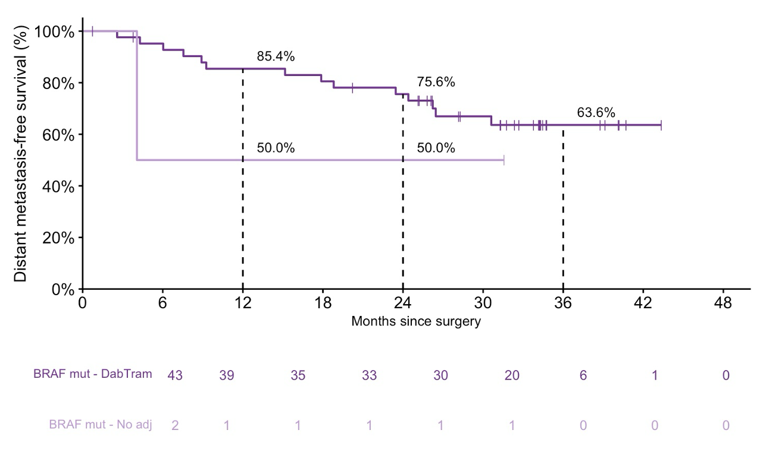
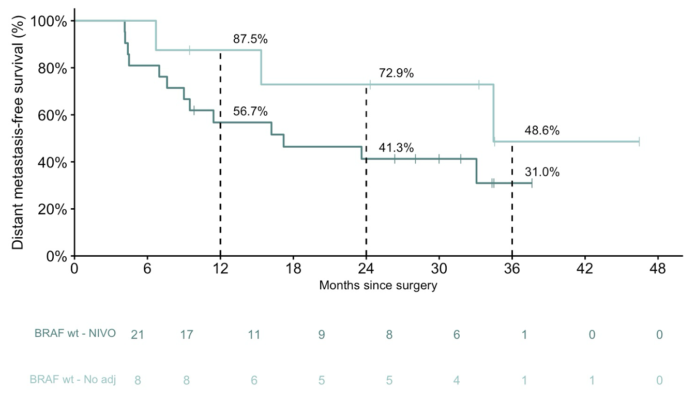
Adjuvant seems to not add clinical benefit in non-MPR patients
Distant metastasis-free survival - BRAF V600E/K
Distant metastasis-free survival - BRAF wildetype & other
In the neoadjuvant arm, patients with pPR or pNR were intended to receive adjuvant Dabrafenib + Trametinib (Dab/Tram) in case of a BRAF^{V600E/K} mutated melanoma or adjuvant nivolumab in case of BRAF wildtype melanoma or a rare mutation.
Sonja J. Witteveen

Slide 10
Summary
At 3 years, the EFS and DMFS remain superior for neoadjuvant with similar HR
pCR remains associated with an excellent outcome, even without adjuvant
Near-pCR patients have a worse outcome than in previous analyses¹
Neoadjuvant is superior regardless of BRAF mutation status
Adjuvant therapy after non-MPR remains debatable
1 Long GL, et al. Annals of Oncology 2024; 35S1232
Sonja J. Witteveen

Slide 11
Acknowledgements
Patients and their families;
Bristol-Myers Squibb for funding this trial, and the National Health and Medical Research Council (NHMRC) who additionally supported this trial in Australia;
Trial teams from the Netherlands Cancer Institute (NKI) and Melanoma Institute Australia (MIA);
Christian Blank and Georgina Long as the lead investigators.
Sonja J. Witteveen

Slide 12
Participating centers
Australia
Shahneen Sandhu
Peter MacCallum Cancer Center
Matteo Carlino
Westmead Hospital
Miles Andrews
Alfred Health
Victoria Atkinson
Princess Alexandra Hospital
Adnan Khattak
Fiona Stanley Hospital
Andre van der Westhuizen
Lake Macquarie Private Hospital
Georgina Long
Melanoma Institute Australia
France
Celeste Lebbé
Hospital St. Louis – AP-HP
Caroline Robert
Institute Gustave Roussy
Mona Amini-Adle
Hospital Léon Bérard
The Netherlands
Astrid van der Veldt
Erasmus MC
Karijn Suijkerbuijk
UMC Utrecht
Ellen Kapiteijn
Leiden UMC
Jan-Willem de Groot
Isala Hospital
Geke Hospers
UMC Groningen
Marye-Boers Sonderen
Radboud UMC
Fons van den Eertwegh
Amsterdam UMC
Marion Stevense
Amphia Hospital
Art Vreugdenhil
Maxima MC
Maureen Aarts
Maastricht UMC
Franchette van den Berkmortel
Zuyderland Hospital
Djura Piersma
MS Twente
Rozemarijn van Rijn
MC Leeuwarden
Christian Blank
The Netherlands Cancer Institute
Italy
Paolo Ascierto
IRCCS - Fondazione Pascale
Poland
Piotr Rutkowski
Marie-Sklowdoska Curie
USA
Mark Faries
The Angeles Clinic &
Research Institute
Sonja J. Witteveen

