Slide 1
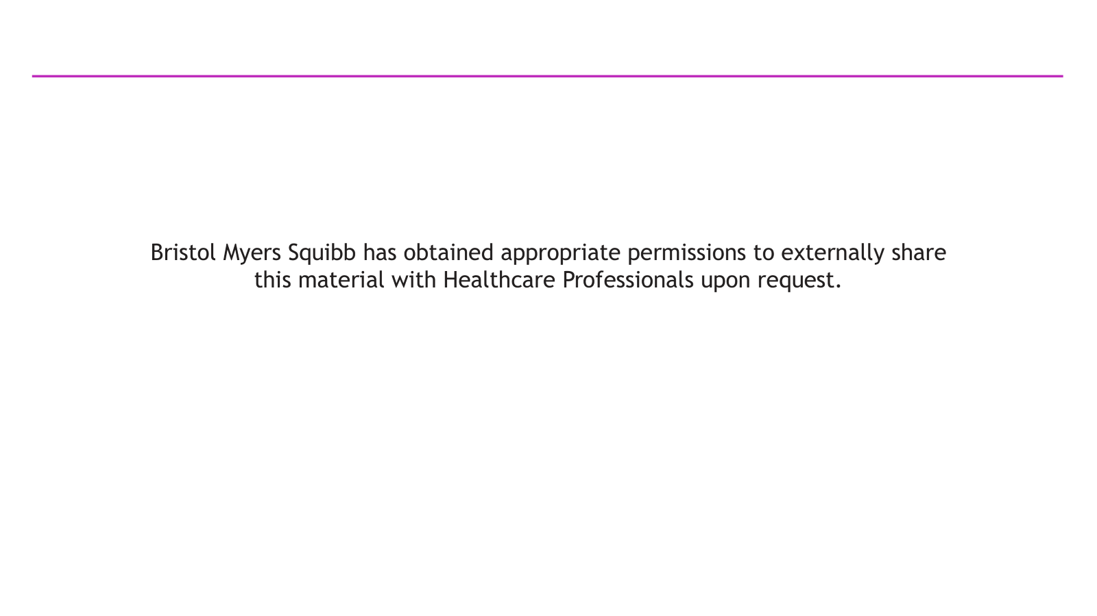

Slide 2
PANKU-Lung01: Randomized Phase III Study of Izalontamab Brengitecan (iza-bren) vs Platinum‑Based Chemotherapy (PBC) in Patients with EGFR-Mutant Non-squamous Non‑Small Cell Lung Cancer (NSCLC) After Progression on a Third-Generation EGFR Tyrosine Kinase Inhibitor (TKI)
Li Zhang¹, Yunpeng Yang², Xiangjiao Meng², Zhihuang Hu³, Wei Zheng⁴, Jiuwei Cui⁵, Yongzhong Luo⁶, Lin Wu⁶, Meijuan Huang⁷, Haipeng Xu⁸, Jie Hu⁹, Yanqiu Zhao¹⁰, Wenxiu Yao¹¹, Sa Xiao¹², Hai Zhu¹³, Yi Zhu¹⁴
¹Department of Medical Oncology, Sun Yat-sen University Cancer Center, Guangzhou, China; ²Department of Radiation Oncology, Shandong Cancer Hospital and Institute, Shandong First Medical University, Jinan, China; ³Department of Medical Oncology, Fudan University Shanghai Cancer Center, Shanghai, China; ⁴Department of Radiotherapy, Shengjing Hospital of China Medical University, Shenyang, China; ⁵Department of Cancer Center, The First Hospital of Jilin University, Changchun, China; ⁶Department of Thoracic Medical Oncology, Hunan Cancer Hospital/The Affiliated Cancer Hospital of Xiangya School of Medicine, Central South University, Changsha, China; ⁷Department of Thoracic Oncology, West China Hospital of Sichuan University, Chengdu, China; ⁸Department of Thoracic Oncology, Clinical Oncology School of Fujian Medical University, Fujian Cancer Hospital, Fuzhou, China; ⁹Department of Respiratory Medicine, Shanghai Geriatric Medical Center, Zhongshan Hospital, Fudan University, Shanghai, China; ¹⁰Department of Medical Oncology, The Affiliated Cancer Hospital of Zhengzhou University & Henan Cancer Center, Zhengzhou, China; ¹¹Department of Thoracic Oncology, Sichuan Clinical Research Center for Cancer, Sichuan Cancer Hospital & Institute, Sichuan Cancer Center, University of Electronic Science and Technology of China, Chengdu, China; ¹²Medical and Pharmacological Research Department, Baili-Bio (Chengdu) Pharmaceutical Co., Ltd., Chengdu, China; ¹³Department of Biometrics, SystImmune Inc., Redmond, United States of America; ¹⁴President and CSO, Sichuan Biokin Pharmaceutical Co., Ltd, Chengdu, China
Presented by
Li Zhang, MD
Sun Yat-sen University Cancer Center, Guangzhou, China
26 October 2026

Slide 3
Declaration of interest
Professor Li Zhang
  Personal: Akesobio, Invited Speaker; Baili-Bio (Chengdu) Pharmaceutical Co., Ltd., Invited Speaker.
  Institutional: Akesobio, Trial Chair; AZ, Research Grant & Trial Chair; CHINA SHIYAO PHARMA, Trial Chair; Hengrui Pharm, Trial Chair; KELUN PHARM, Trial Chair; Novartis, Trial Chair; Pierre-Fabre, Trial Chair; Pfizer, Trial Chair; QiLu pharm, Trial Chair; Roche, Research Grant; Baili-Bio (Chengdu) Pharmaceutical Co., Ltd., Trial Chair.
This study was sponsored by Baili-Bio (Chengdu) Pharmaceutical Co., Ltd.

Slide 4
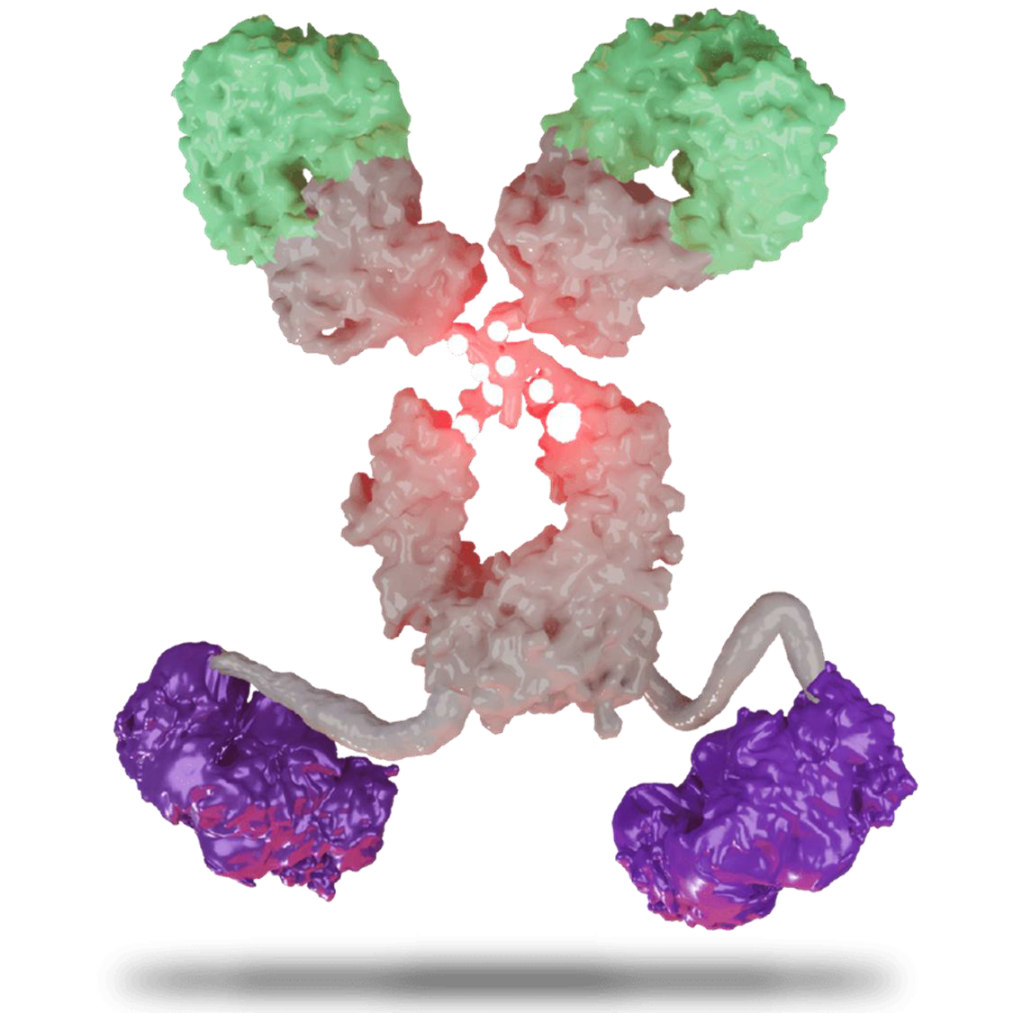
Background
Iza-bren, EGFR×HER3 bispecific ADC
EGFR TKI is the standard therapy for advanced EGFR-mutant NSCLC. However, most patients inevitably develop resistance¹. Following disease progression on 3rd generation TKIs, platinum-based chemotherapy remains a common treatment option². Therapeutic options with improved efficacy are still needed.
Izalontamab brengitecan (iza-bren, BL-B01D1) is a first-in-class bispecific ADC targeting EGFRxHER3 bound to a novel topo I inhibitor (Ed-04) via a cleavable linker.
In previous phase I and II studies, iza-bren showed promising antitumor activity in patients with EGFR-mutant NSCLC after EGFR TKI therapy (cORR, 56.0%; mDOR, 13.7 months; mPFS, 12.5 months)³.
αEGFR
Human EGFR
Affinity: High
DAR = 8
Cat B cleavable linker
Ed-04 (top1i)
wt Fc IgG1
αHER3
Human HER3
Affinity: Low
Here we report the interim analysis results from a randomized phase III study evaluating the efficacy and safety of iza-bren vs PBC in patients with EGFR-mutant NSCLC after progression on 3rd generation EGFR TKI (PANKU-Lung01).
Wt, wild type; Cat B, cathepsin B
1. Lung Cancer 194 (2024) 107895; 2. Lung Cancer 181 (2023) 107248; 3. Ann Oncol. 2026 Jun;37(6):813-824
Li Zhang

Slide 5
PANKU-Lung01 Study Design
PANKU-Lung01 study is an open-label, multicenter, randomized, phase III study
Key eligibility criteria
Locally advanced or metastatic non-squamous NSCLC
Documented EGFR sensitizing mutant (exon 19 deletion or L858R)
Progressed on prior 3rd-generation EGFR TKI therapy (up to 2 prior lines of EGFR TKI)
Treated/stable CNS metastasis allowed
Measurable lesion per RECIST v1.1
ECOG PS 0-1
Iza-bren
2.5 mg/kg D1D8 Q3W
Primary endpoint: PFS (BICR)
Key secondary endpoint: OS
R 1:1
N=432
H_{PFS}
α=0.025
H_{OS}
α=0
PBC
Pemetrexed + Cisplatin/Carboplatin Q3W
Stratified by
ECOG PS (0 vs 1)
CNS metastases (Yes vs No)
Prior anti-angiogenic therapy (Yes vs No)
Other secondary endpoints
    PFS (INV)
    ORR (BICR & INV)
    DCR (BICR & INV)
    DOR (BICR & INV)
    Safety, PK, Immunogenicity
Treatment until
Disease progression per RECIST v1.1 or intolerable toxicity
Note: Iza-bren was dosed with 10% compensation per protocol; pemetrexed 500 mg/m² plus cisplatin 75 mg/m² or pemetrexed 500 mg/m² plus carboplatin (AUC 5) Q3W.
ECOG PS, Eastern Cooperative Oncology Group performance status; Q3W, every 3 weeks; AUC, area under the curve; CNS, central nervous system
PFS, progression-free survival; BICR, blinded independent central review; OS, overall survival; INV, investigator assessed; ORR, objective response rate (confirmed); DCR, disease control rate; DOR, duration of response.
Li Zhang

Slide 6
Patient Disposition
654 Patients screened
222 Screen failure
212 Did not meet inclusion or met exclusion criteria
5 Patients withdrew informed consent
5 Patients due to other reasons
432 Patients randomized
217 Assigned to
iza-bren arm (ITT)
215 Assigned to comparator arm (ITT)
1 Not treated
9 Not treated
155 End of treatment
103 Progressive disease
23 Voluntarily withdrawal
10 Adverse events
7 Treatment delayed for > 28 days
7 Investigator’s decision
1 Death
1 Initiation of new anti-cancer therapy
3 Other
216 Treated with
iza-bren (mITT)
206 Treated with
PBC (mITT)
193 End of treatment
156 Progressive disease
20 Voluntarily withdrawal
2 Adverse events
4 Treatment delayed for > 28 days
6 Investigator’s decision
2 Death
1 Initiation of new anti-cancer therapy
2 Other
61 Treatment ongoing
13 Treatment ongoing
Data cut off: July 15, 2026
Li Zhang

Slide 7
Baseline Demographics
 | Iza-bren (N = 216) | PBC (N = 206)
Median (range) age, years | 59.5 (37.0, 78.0) | 61.0 (31.0, 79.0)
Age group (years), n (%)
< 65 | 155 (71.8) | 139 (67.5)
≥ 65 | 61 (28.2) | 67 (32.5)
Sex, n (%)
Male | 94 (43.5) | 92 (44.7)
Female | 122 (56.5) | 114 (55.3)
ECOG PS, n (%)
0 | 51 (23.6) | 47 (22.8)
1 | 165 (76.4) | 159 (77.2)
Smoking status, n (%)
Never | 153 (70.8) | 147 (71.4)
Former/Current | 63 (29.2) | 59 (28.6)
CNS metastases, n (%)
Yes | 21 (9.7) | 21 (10.2)
No | 195 (90.3) | 185 (89.8)
Liver metastases, n (%) | 29 (13.4) | 26 (12.6)
 | Iza-bren (N = 216) | PBC (N = 206)
EGFR mutation type, n (%)
EGFR Exon 19 deletion | 117 (54.2) | 122 (59.2)
EGFR Exon 21 L858R | 99 (45.8) | 85 (41.3)
EGFR T790M | 18 (8.3) | 20 (9.7)
Other | 3 (1.4) | 2 (1.0)
Metastatic status , n (%)
Yes | 214 (99.1) | 205 (99.5)
Number of metastatic organs < 3 | 88 (40.7) | 88 (42.7)
Number of metastatic organs ≥ 3 | 126 (58.3) | 117 (56.8)
No | 2 (0.9) | 1 (0.5)
Number of treatment lines, n (%)
1 line | 156 (72.2) | 150 (72.8)
2 lines | 60 (27.8) | 55 (26.7)
3 lines | 0 | 1 (0.5)
Prior anti-angiogenic therapy*, n (%)
Yes | 21 (9.7) | 18 (8.7)
No | 195 (90.3) | 188 (91.3)
Prior TKI, n (%)
1G-TKI/2G-TKI and 3G-TKI | 48 (22.2) | 53 (25.7)
3G-TKI only | 168 (77.8) | 153 (74.3)
Data cut off: July 15, 2026
1G, first-generation; 2G, second-generation; 3G, third-generation. *: including Bevacizumab, Anlotinib, and Endostar.
Data cut off: July 15, 2026
Li Zhang

Slide 8
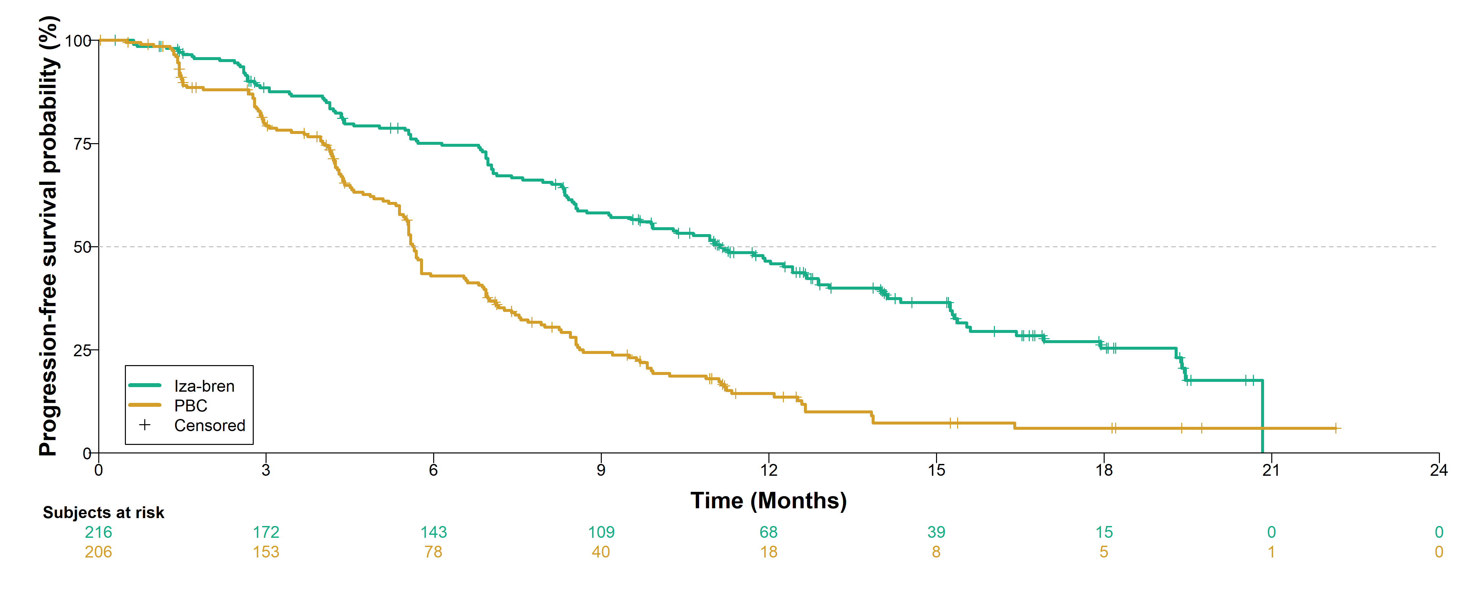
PFS by BICR: Primary Endpoint
Iza-bren showed statistically significant and clinically meaningful improvement vs PBC with doubling of mPFS.
 | Iza-bren (N = 216) | PBC (N = 206)
Number of events | 128 | 164
Median, mo (95% CI) | 11.1 (9.2, 12.7) | 5.7 (5.5, 5.9)
HR (95% CI) | 0.40 (0.31, 0.51)†
P-value | <0.0001*
75.1%
58.2%
42.9%
46.5%
24.4%
14.4%
PFS (BICR) was evaluated in the mITT population. The median duration of follow-up for PFS was 14.6 months.
Similar results were observed for PFS (BICR) in the ITT population, with 129 events in the iza-bren arm and 164 events in the PBC arm. The hazard ratio (95% CI) was 0.40 (0.31, 0.51).
†Based on a stratified Cox regression model. *One-sided, based on a stratified log-rank test.
Li Zhang
Data cut off: July 15, 2026

Slide 9
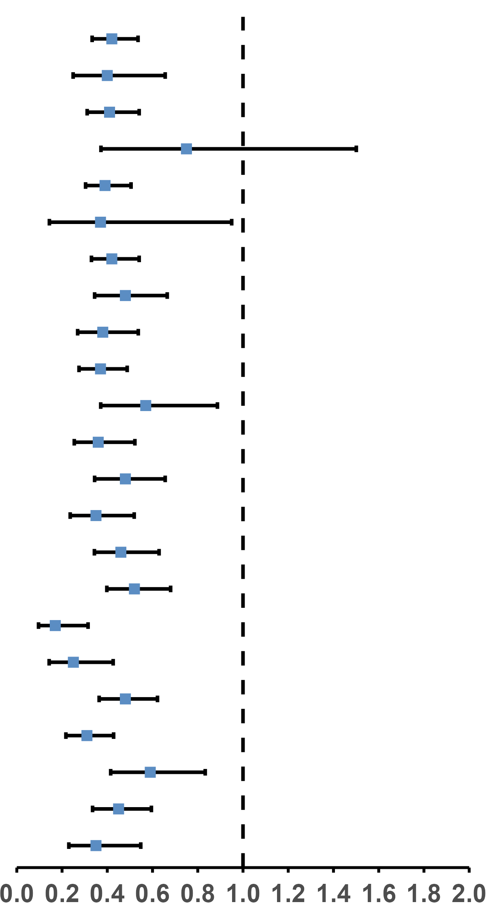
Subgroup Analysis of PFS (BICR)
A consistent PFS benefit of iza-bren over PBC was seen across all predefined subgroups.
Category | Subgroup | Iza-bren | PBC |  | Hazard Ratio (95% CI)
 |  | Events/n | Events/n
All Subjects |  | 128/216 | 164/206 |  | 0.42 (0.33, 0.54)
ECOG PS | 0 | 31/51 | 39/48 |  | 0.40 (0.25, 0.66)
 | 1 | 97/165 | 125/158 |  | 0.41 (0.31, 0.54)
CNS metastases | Yes | 17/21 | 16/20 |  | 0.75 (0.37, 1.50)
 | No | 111/195 | 148/186 |  | 0.39 (0.30, 0.51)
Prior anti-angiogenic therapy | Yes | 10/19 | 12/18 |  | 0.37 (0.14, 0.95)
 | No | 118/197 | 152/188 |  | 0.42 (0.33, 0.54)
Scores of the QLQ-C30 | ≤ Median score | 64/113 | 86/107 |  | 0.48 (0.34, 0.67)
 | > Median score | 64/103 | 78/99 |  | 0.38 (0.27, 0.54)
Age group | < 65 years | 91/155 | 113/139 |  | 0.37 (0.28, 0.49)
 | ≥ 65 years | 37/61 | 51/67 |  | 0.57 (0.37, 0.89)
Sex | Male | 53/94 | 80/92 |  | 0.36 (0.25, 0.52)
 | Female | 75/122 | 84/114 |  | 0.48 (0.34, 0.66)
Number of metastatic organs | < 3 | 41/90 | 70/89 |  | 0.35 (0.24, 0.52)
 | ≥ 3 | 87/126 | 94/117 |  | 0.46 (0.34, 0.63)
Number of prior treatment lines | 1 line | 103/156 | 121/150 |  | 0.52 (0.40, 0.68)
 | 2 lines | 25/60 | 42/55 |  | 0.17 (0.10, 0.32)
Prior TKI | 1G-TKI/2G-TKI and 3G-TKI | 24/48 | 40/53 |  | 0.25 (0.14, 0.43)
 | 3G-TKI only | 104/168 | 124/153 |  | 0.48 (0.36, 0.62)
EGFR mutation type | EGFR Exon 19 deletion | 60/117 | 100/122 |  | 0.31 (0.22, 0.43)
 | EGFR 21 L858R mutation | 68/99 | 64/85 |  | 0.59 (0.41, 0.83)
Smoking status | Never | 89/153 | 111/147 |  | 0.45 (0.34, 0.60)
 | Former/Current | 39/63 | 53/59 |  | 0.35 (0.23, 0.55)
Data cut off: July 15, 2026
Li Zhang
Iza-bren better
PBC better

Slide 10
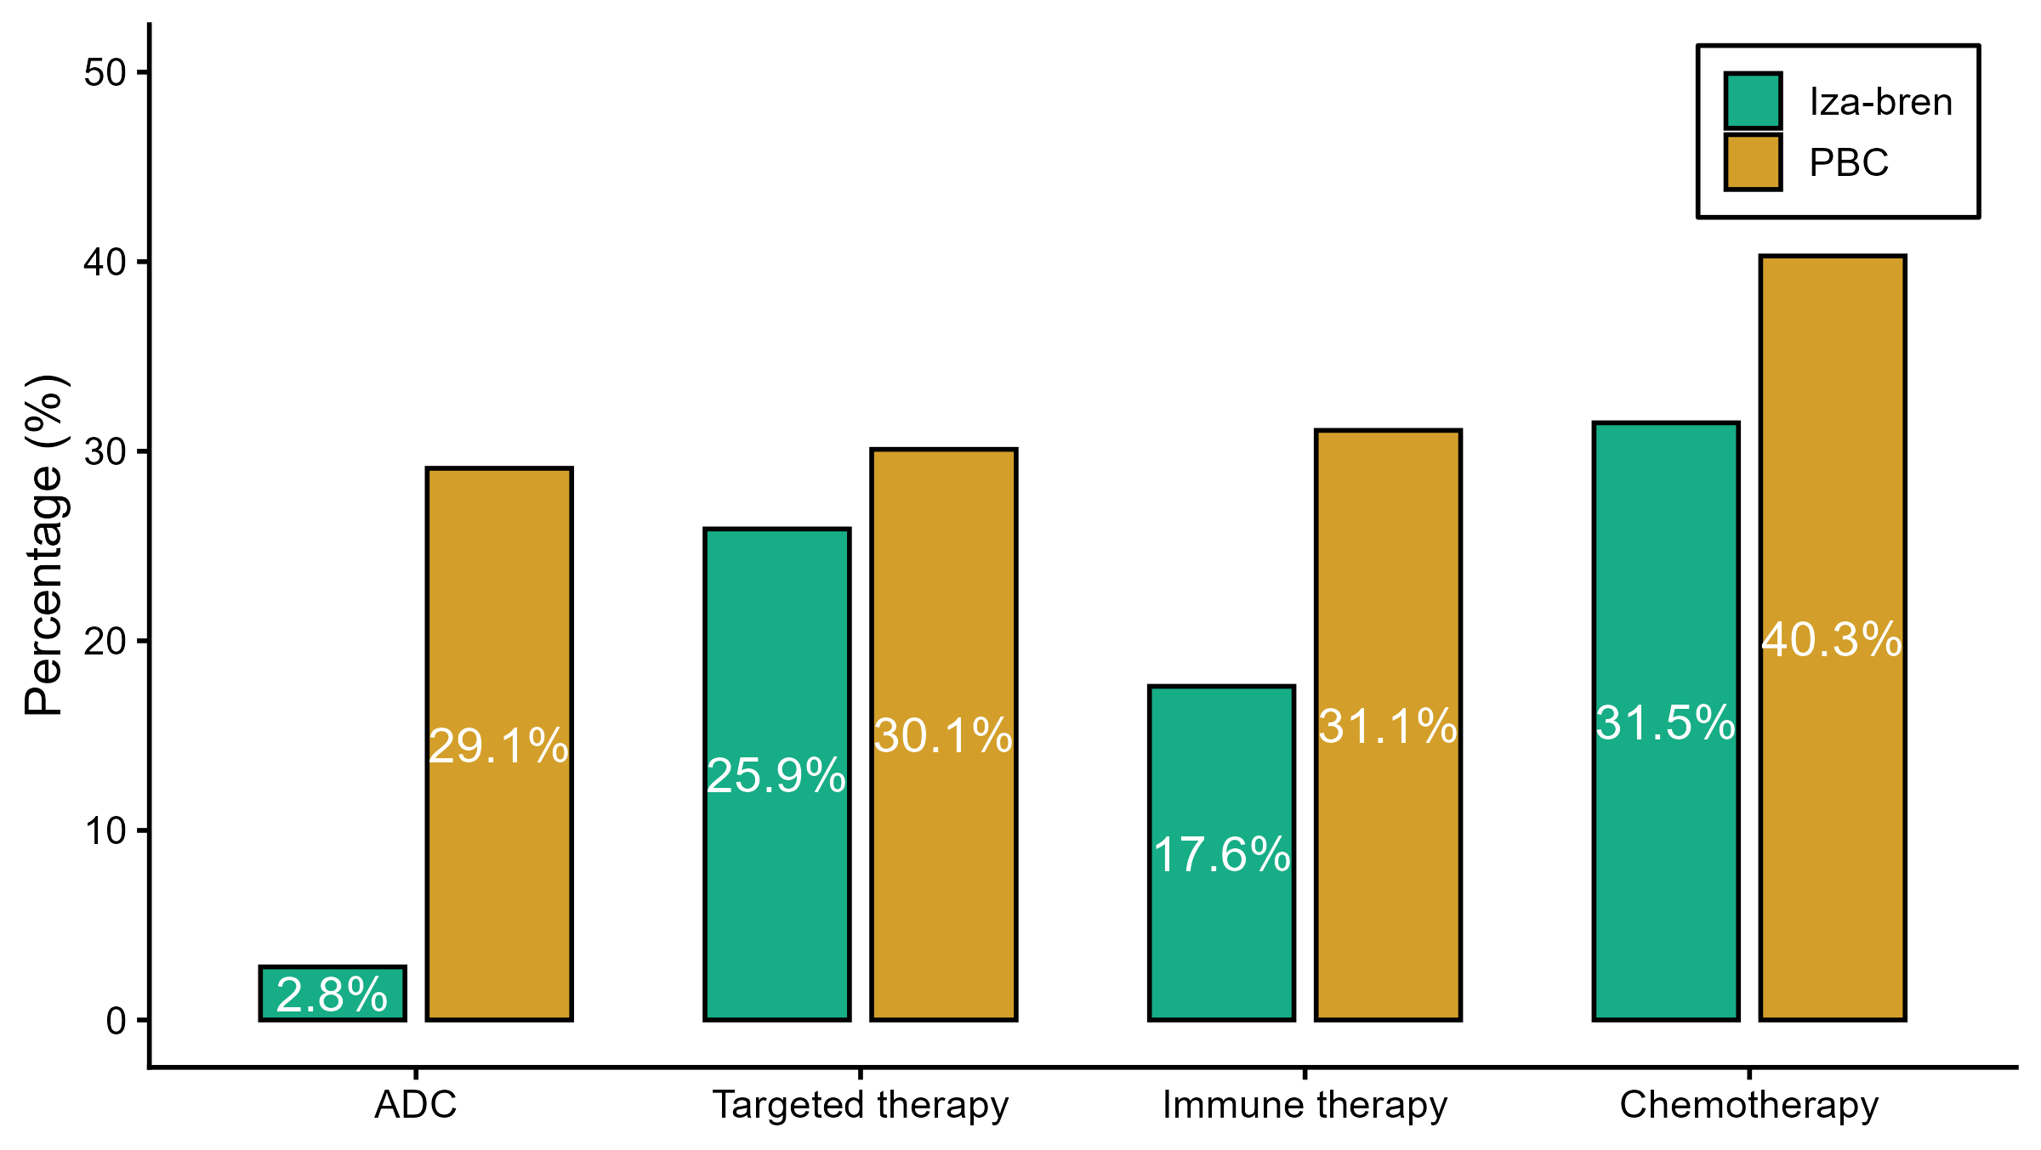
OS: Key Secondary Endpoint
OS data was not mature for both arms. At the interim analysis, a trend of OS benefit favoring iza-bren was observed.
 | Iza-bren (N = 216) | PBC (N = 206)
Number of events (death) | 64 | 82
Median OS, mo (95% CI) | NR (19.3, NR) | 19.4 (16.4, 22.5)
Median follow-up for OS, mo (95% CI) | 16.9 (15.9, 17.7) | 16.5 (15.1, 17.5)
12-mo OS rate (95% CI) | 83.0 (77.3, 87.5) | 72.9 (66.1, 78.5)
18-mo OS rate (95% CI) | 68.8 (60.9, 75.5) | 55.3 (46.8, 63.0)
More patients received subsequent anti-cancer therapy in the PBC arm, including ADCs
OS was evaluated in the mITT population. The overall median duration of follow-up for OS was 16.6 months. Similar results were observed for OS in the ITT population.
Li Zhang
Data cut off: July 15, 2026

Slide 11
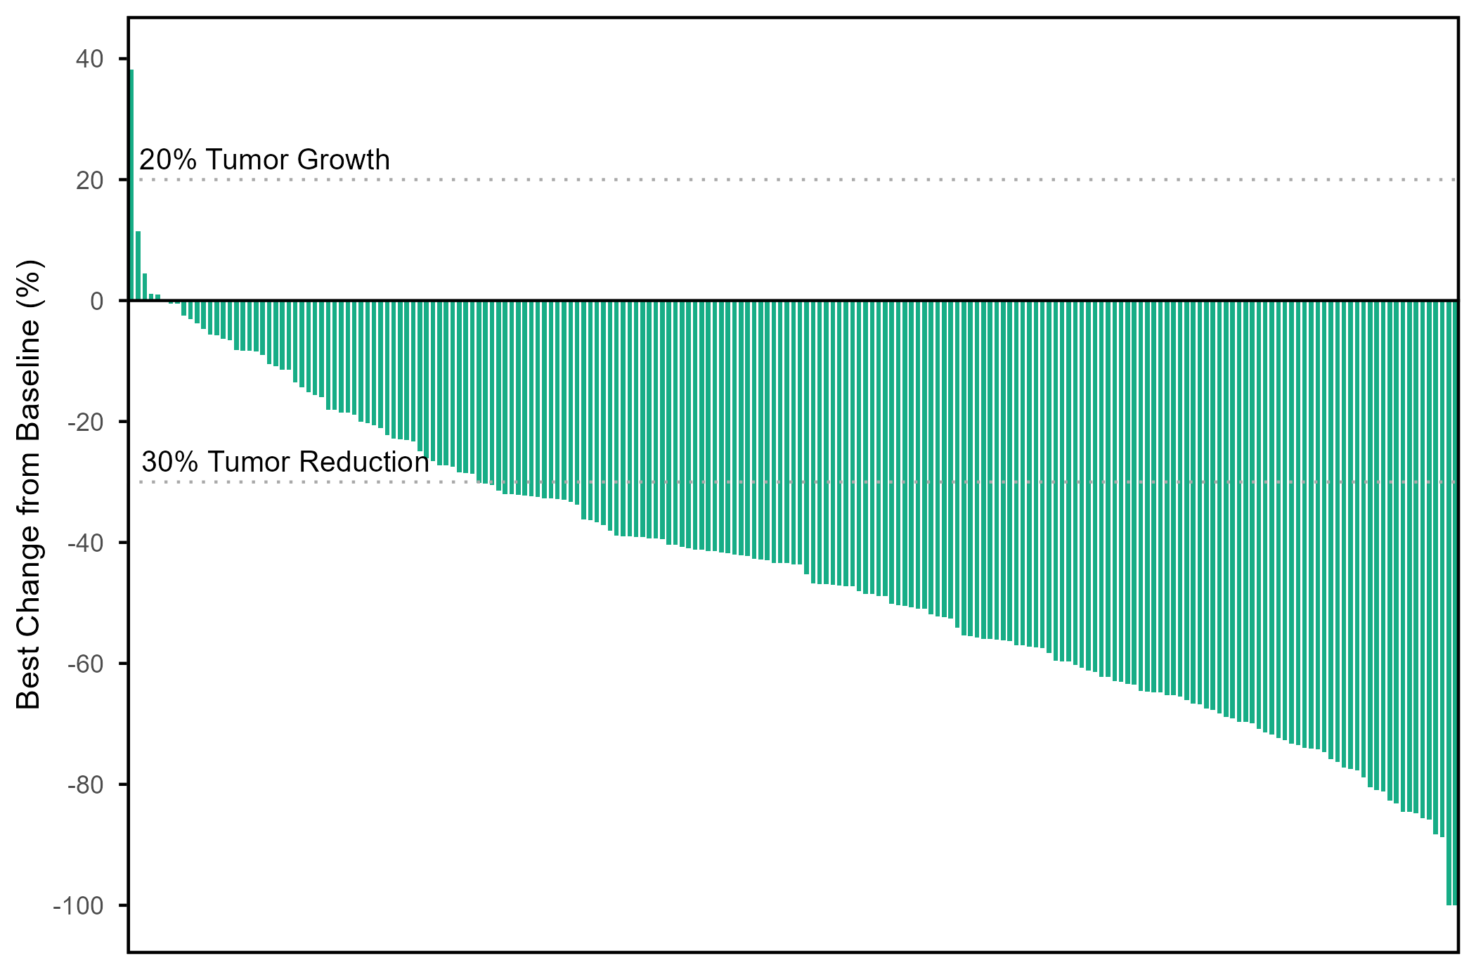
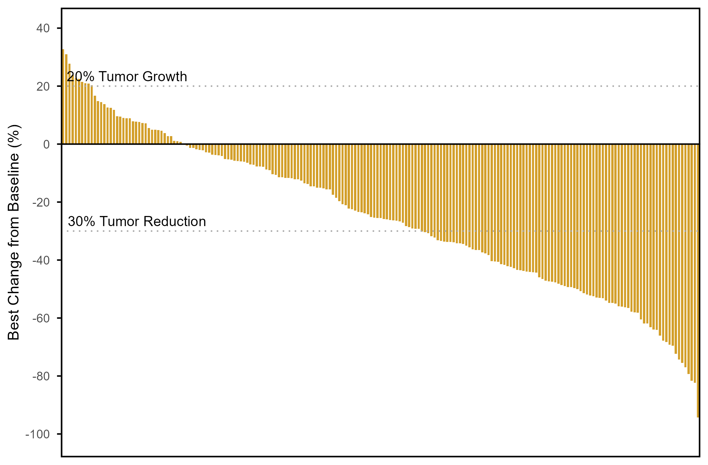
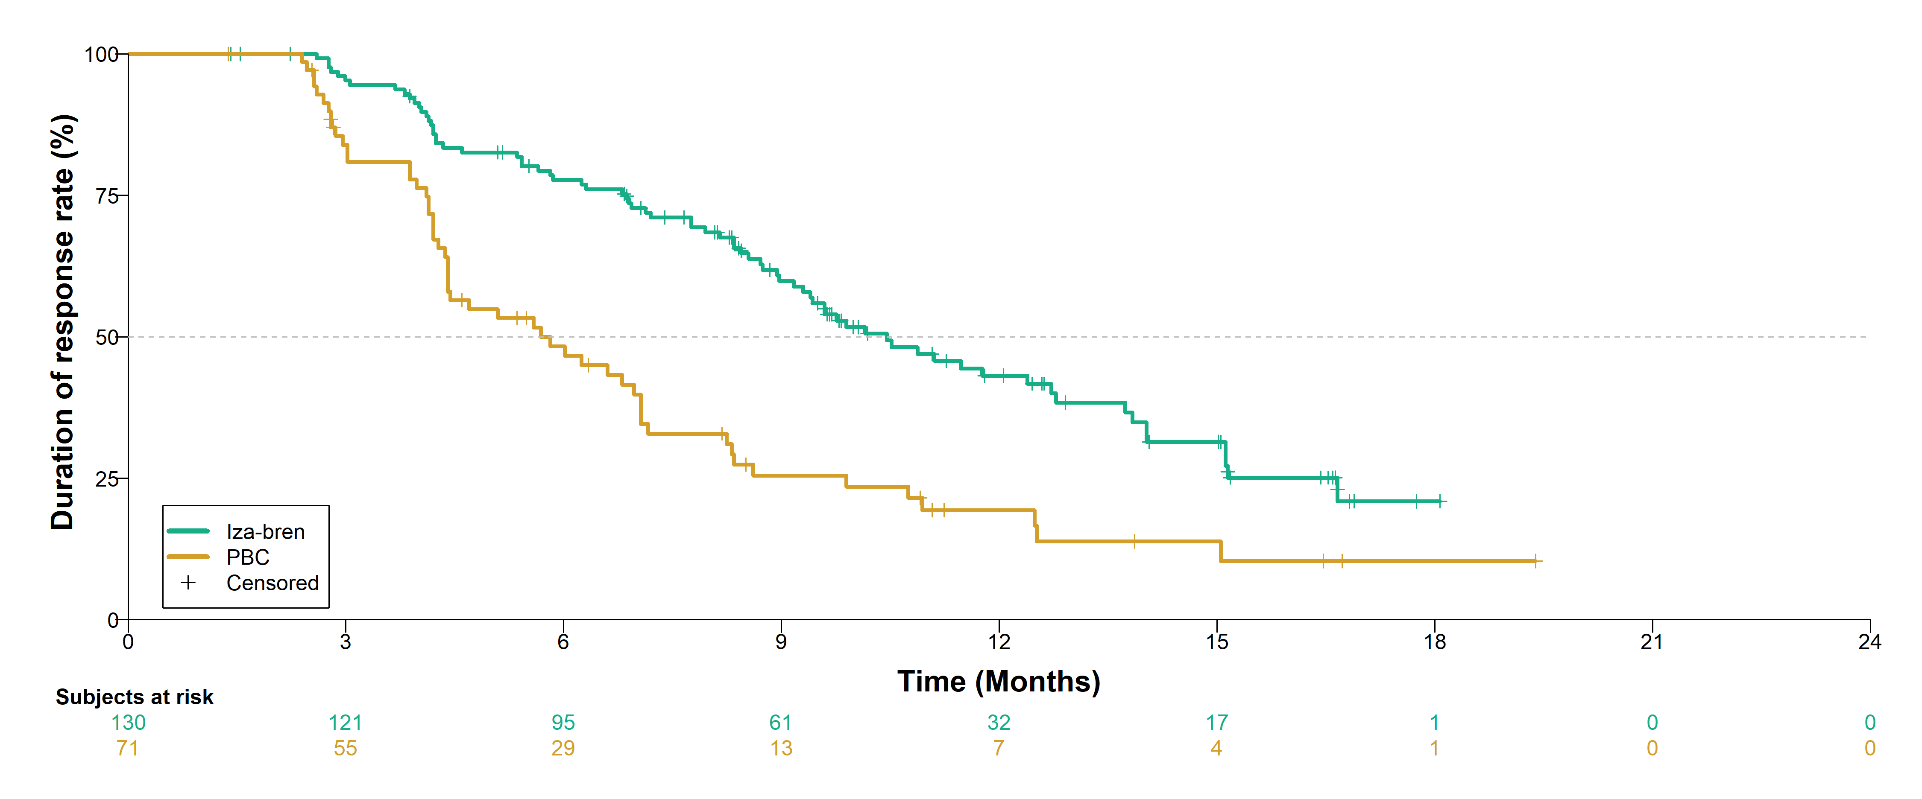
ORR (BICR): Secondary Endpoint
Iza-bren nearly doubled cORR by BICR versus PBC with improved duration of response.
 | Iza-bren (N=216) | PBC (N=206)
Best overall response, n (%)
CR | 1 (0.5) | 0
PR | 129 (59.7) | 71 (34.5)
Non-CR/Non-PD | 1 (0.5) | 2 (1.0)
SD | 61 (28.2) | 102 (49.5)
PD | 9 (4.2) | 25 (12.1)
NE | 15 (6.9) | 6 (2.9)
Confirmed ORR, % (95% CI) | 60.2 (53.3, 66.8) | 34.5 (28.0, 41.4)
Difference, % (95% CI) | 25.6 (16.2, 34.6)
Odds ratio (95% CI) | 2.9 (1.9, 4.3)
DCR, % (95% CI) | 88.9 (83.9, 92.8) | 85.0 (79.3, 89.5)
Iza-bren
PBC
 | Iza-bren | PBC
Median DoR, mo (95% CI) | 10.4 (9.2, 12.7) | 5.7 (4.4, 7.1)
HR (95% CI) | 0.41 (0.29, 0.60)
In the iza-bren arm, 91.2% of patients (197/216) had tumor shrinkage and the median (range) shrinkage (%) was -46.8 (-100, -0.5); in the PBC arm, 78.6% of patients (162/206) had tumor shrinkage and the median (range) shrinkage (%) was -33.5 (-94.4, -0.5).
ORR, objective response rate (confirmed); DCR, disease control rate; DoR, duration of response; CR, complete response; PR, partial response; SD, stable disease; PD, progressive disease; NE, not evaluable.
Li Zhang
Data cut off: July 15, 2026

Slide 12
Safety Summary
 | Iza-bren (N = 216) | PBC (N = 206)
TRAEs, n (%) | 216 (100) | 204 (99.0)
≥Grade 3 TRAEs, n (%) | 170 (78.7) | 128 (62.1)
Treatment-related SAEs, n (%) | 92 (42.6) | 40 (19.4)
TRAEs leading to death, n (%) | 1 (0.5) | 1 (0.5)
TRAEs leading to treatment discontinuation, n (%) | 4 (1.9) | 4 (1.9)
TRAEs leading to dose reduction, n (%) | 130 (60.2) | 48 (23.3)
TRAEs leading to dose interruption, n (%) | 116 (53.7) | 49 (23.8)
Median (range) duration of treatment, mo:
  Iza-bren: 10.3 (0.3, 22.7)
  PBC: Pemetrexed 5.7 (0.2, 23.5); Cisplatin/Carboplatin 3.1 (0.2, 5.8)
  Median (range) number of treatment cycles:
  Iza-bren: 13 (1, 31)
  PBC: Pemetrexed 8 (1, 33); Cisplatin/Carboplatin 4 (1, 7)
≥Grade 3 TRAEs and treatment-related SAEs were higher in iza-bren group; the safety profile of iza-bren was manageable through standard supportive care including dose delay and dose reductions.
The rate of treatment discontinuation due to TRAEs was low in both groups (1.9%).
TRAE, treatment related adverse events.
Safety data based on the safety analysis set.
TRAEs leading to death: iza-bren arm, 1 patient died due to sepsis; in pbc arm, 1 patient died due to unknown cause.
Data cut off: July 15, 2026
Li Zhang

Slide 13
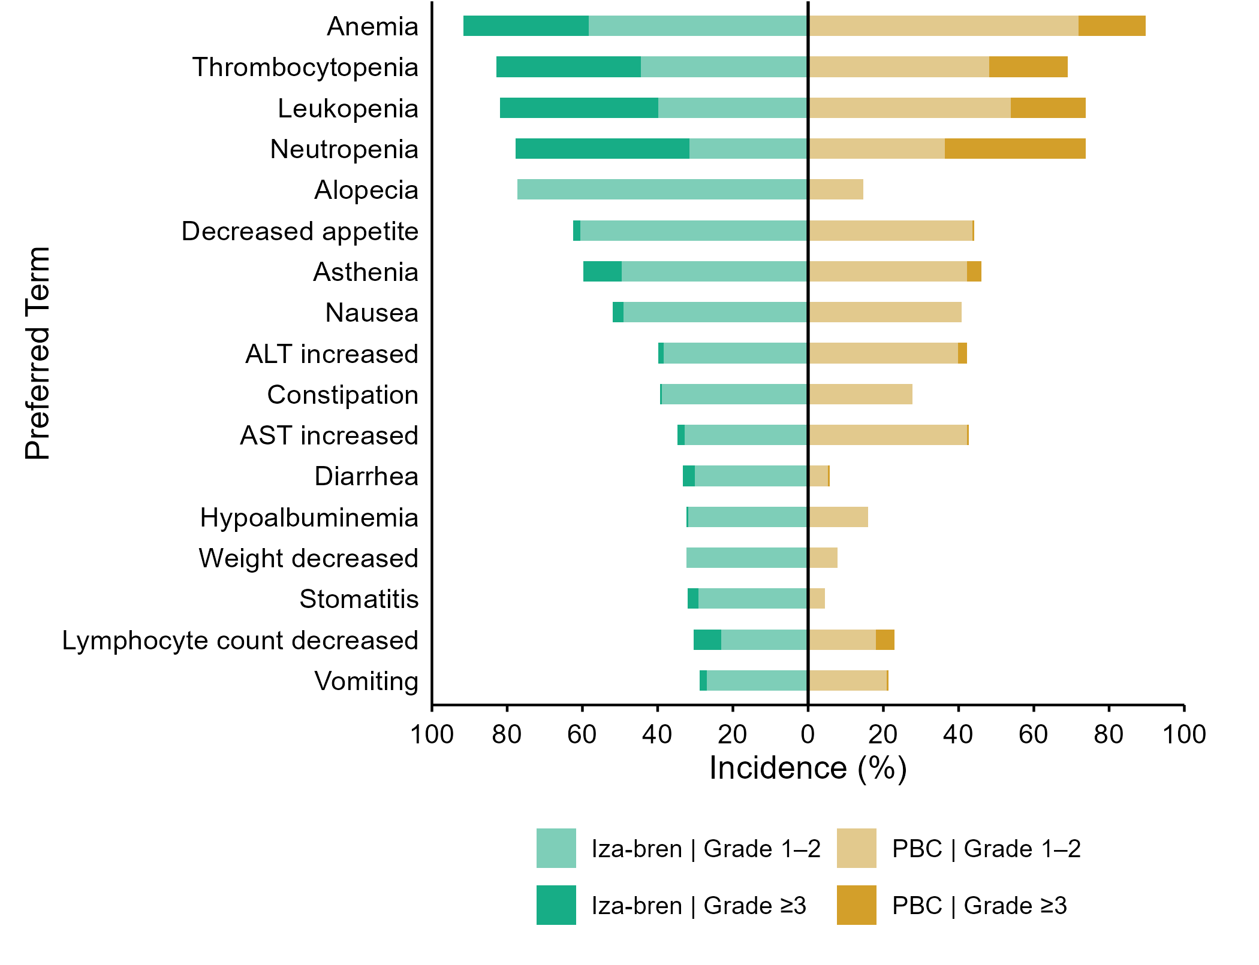
TRAEs in ≥ 20% of Patients
Most common TRAEs were hematologic toxicities, which were effectively managed with standard supportive care including growth factor support, dose delay and reductions, which allowed majority of patients to continue iza-bren treatment with a low discontinuation rate. Primary G-CSF prophylaxis was not mandatory.
In the iza-bren arm, Grade ≥3 anemia resolved in a median of 8.0 days; Grade ≥3 neutropenia and thrombocytopenia generally resolved within 2.0 to 3.0 days. The incidence of febrile neutropenia was low (6.0%).
Non-hematologic AEs were mostly low grade; asthenia was the most common grade ≥ 3 non-hematologic AEs in both groups (11.1% with iza-bren and 3.9% with PBC).
Treatment-related ILD occurred in two patients (0.9%) in the iza-bren arm (one grade 1 and one grade 3). None in the PBC arm.
33.3
58.4
71.8
18.0
38.4
44.5
48.0
20.9
42.1
39.8
53.9
19.9
46.3
31.5
36.4
37.4
77.3
14.6
1.9
61.1
44.6
1.0
11.1
50.9
44.6
3.9
2.8
49.1
40.8
1.4
38.4
39.8
2.4
0.5
38.9
27.7
1.9
32.8
42.2
0.5
3.2
30.1
5.8
0.5
0.5
31.9
16.0
32.4
7.8
2.9
29.1
4.4
7.4
23.2
17.9
4.9
1.9
26.8
20.9
0.5
Li Zhang
Data cut off: July 15, 2026

Slide 14
Conclusions
Iza-bren demonstrated a statistically significant and clinically meaningful improvement in PFS vs PBC in patients with EGFR-mutant non-squamous NSCLC after progression on a 3rd generation EGFR TKI
At this interim analysis, OS remained immature and a trend towards OS improvement with iza-bren was observed.
Iza-bren demonstrated an improved response rate with durable response vs. PBC.
The safety profile of iza-bren was manageable and consistent with previous studies.
These results support iza-bren as a promising new treatment option for EGFR-mutant NSCLC patients with EGFR TKI resistance.
Global registrational studies in EGFR-mutant NSCLC patients after progression on a third-generation EGFR TKI and in the first line setting are ongoing (IZABRIGHT-Lung01, NCT07100080; IZABRIGHT-Lung02, NCT 07680790).
Li Zhang

Slide 15

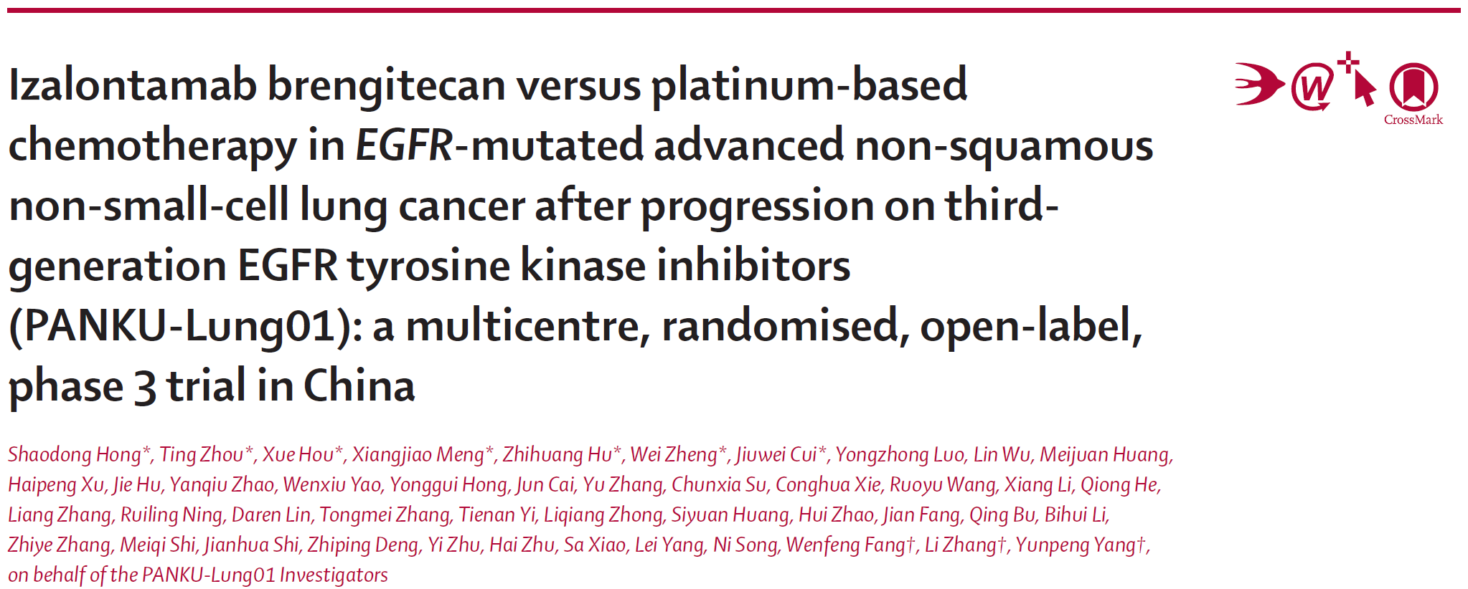

Publication
https://doi.org/10.1016/S0140-6736(26)02026-X.
Li Zhang

Slide 16
Acknowledgments
Thank all patients who participated in this study, their families, and their caregivers.
Thank all investigators and research staff in this study.
Thank 2026 ESMO Congress Organization Committee.
Li Zhang

